Slide 1
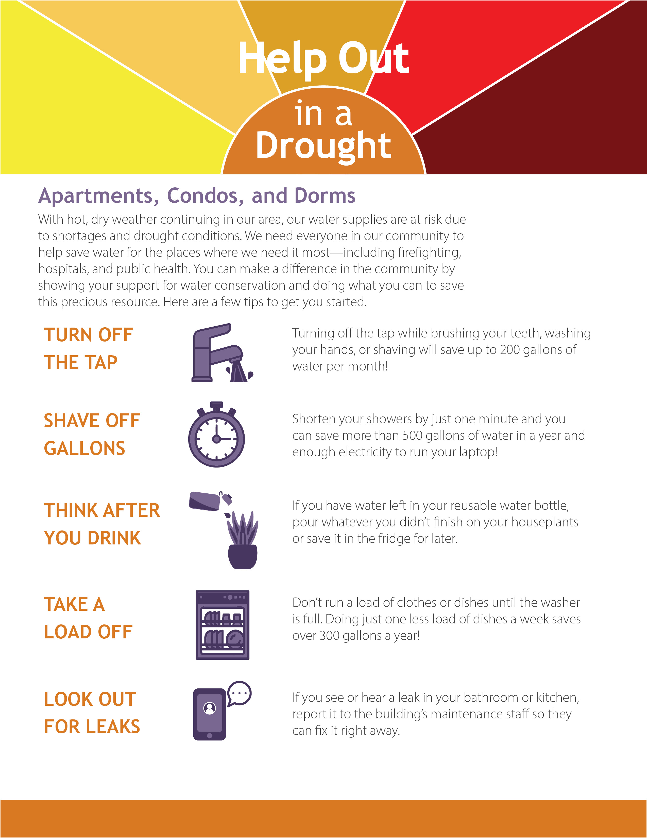
For more information, contact:
www.epa.gov/watersense/drought-watersense

