Slide 1

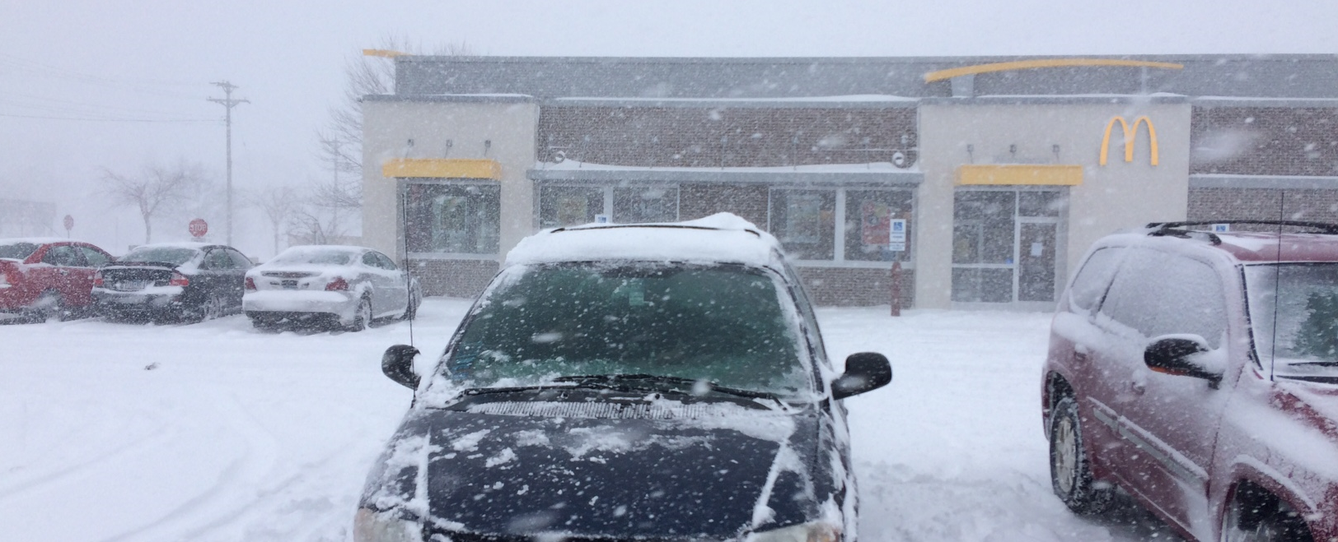
Climate Change in Minnesota
December 11, 2019
Thunder Blizzard of April 13-16, 2018
Courtesy: Pete Boulay MNDNR
Pete Boulay, MNDNR State Climatology Office
Peter.Boulay@state.mn.us 651-296-4214

Slide 2
Items to Bear in Mind
Our climate story differs from other parts of US & world
Observations & Projections are different
We can (and do have) Variability and Trends simultaneously – they do not disprove each other!
Seek more info and refresh frequently!

Slide 3
Two Main, Interrelated Trends
Wetter: more precipitation, more snow, more frequent and larger extremes
Observed already, projected to continue, with wet/dry variability
Warmer: Especially at night, during winter, and when it’s generally cold
Cold extremes less common and less severe

Slide 4
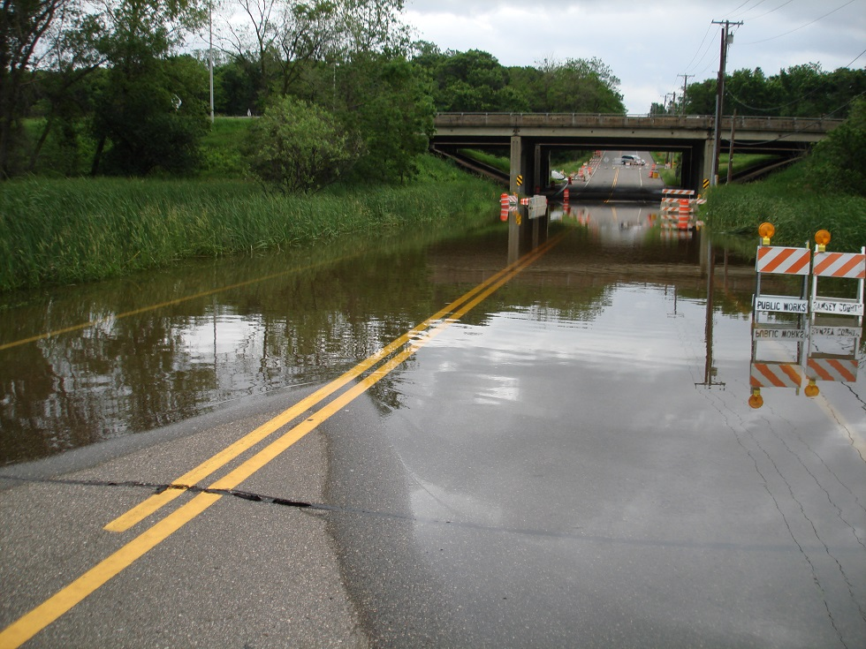
MN Getting Warmer and Wetter
County Road B East of Rice Street: June 2014
Courtesy: MNDNR State Climatology Office

Slide 5
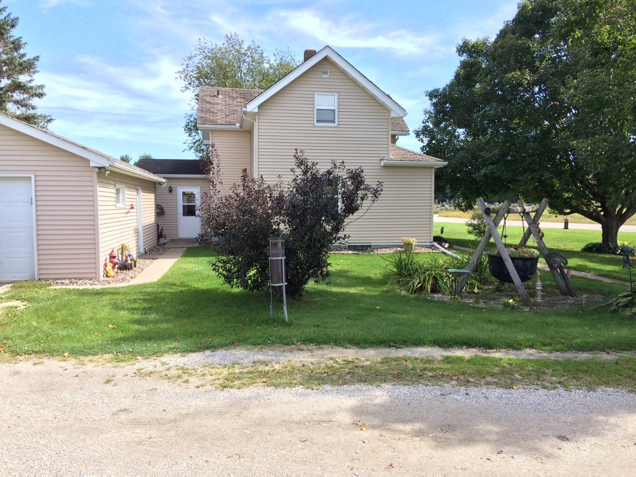
Precipitation Trends
Example of a National Weather Service rain gauge in Harmony, MN
May have 50 inches of precipitation for two years in a row.

Slide 6
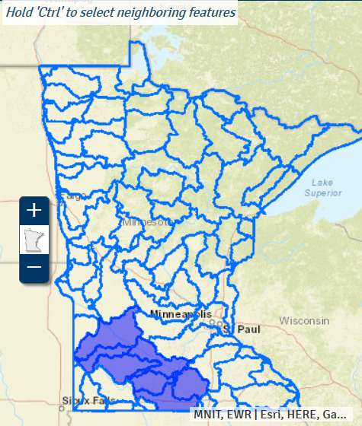
Much of MN Currently Experiencing Wettest Decade on Record
https://arcgis.dnr.state.mn.us/ewr/climatetrends/#

Slide 7
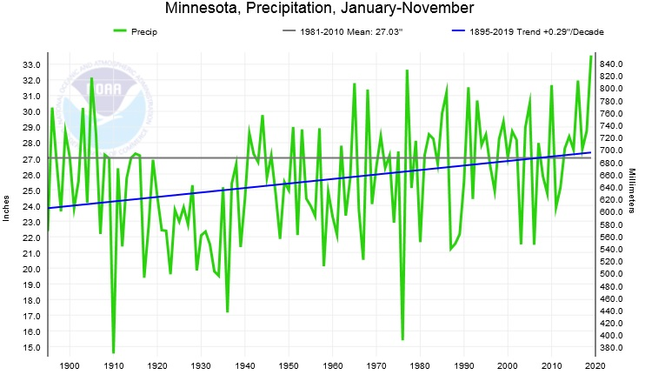
Minnesota: NOAA Climate at a Glance http://www.ncdc.noaa.gov/cag/

Slide 8
Minnesota: NOAA Climate at a Glance http://www.ncdc.noaa.gov/cag/

Slide 9
Minnesota: NOAA Climate at a Glance http://www.ncdc.noaa.gov/cag/

Slide 10
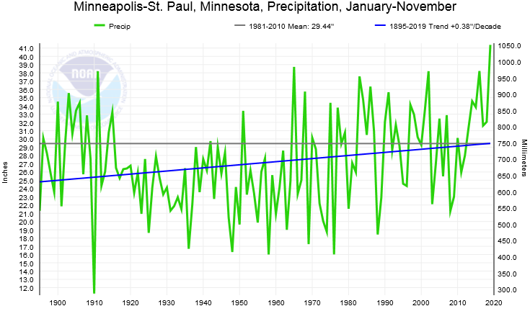
2019: Wettest Year on Record in the Twin Cities http://www.ncdc.noaa.gov/cag/

Slide 11
More 1” Precipitation Events

Slide 12
Heaviest Rain in State Often Larger, More Variable

Slide 13
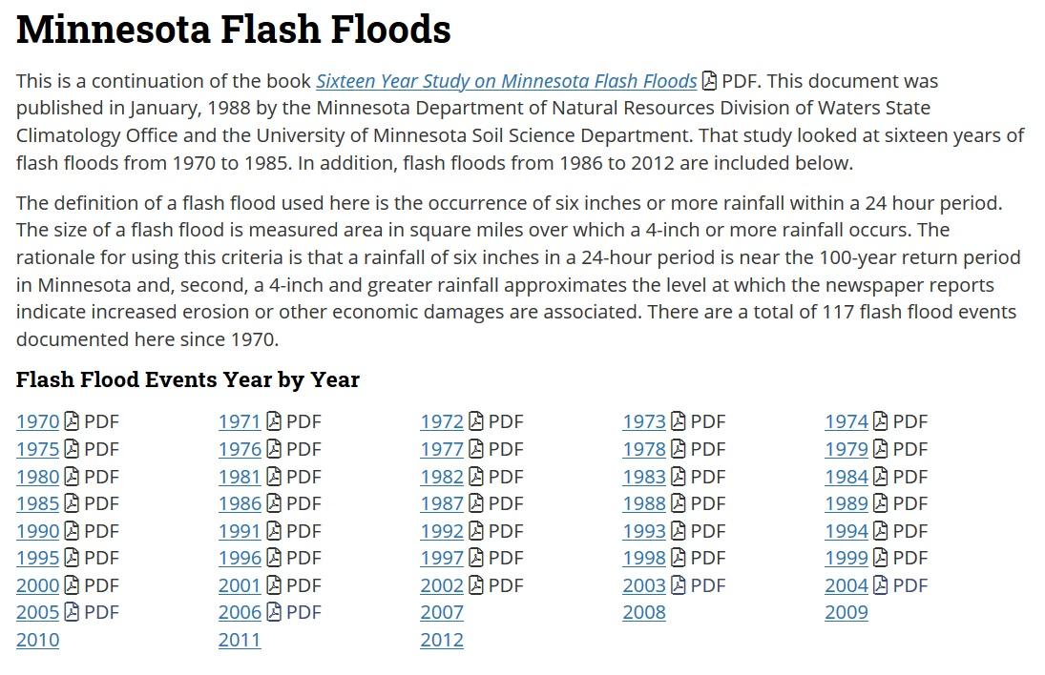
Past Flash Floods: Climate.umn.edu

Slide 14
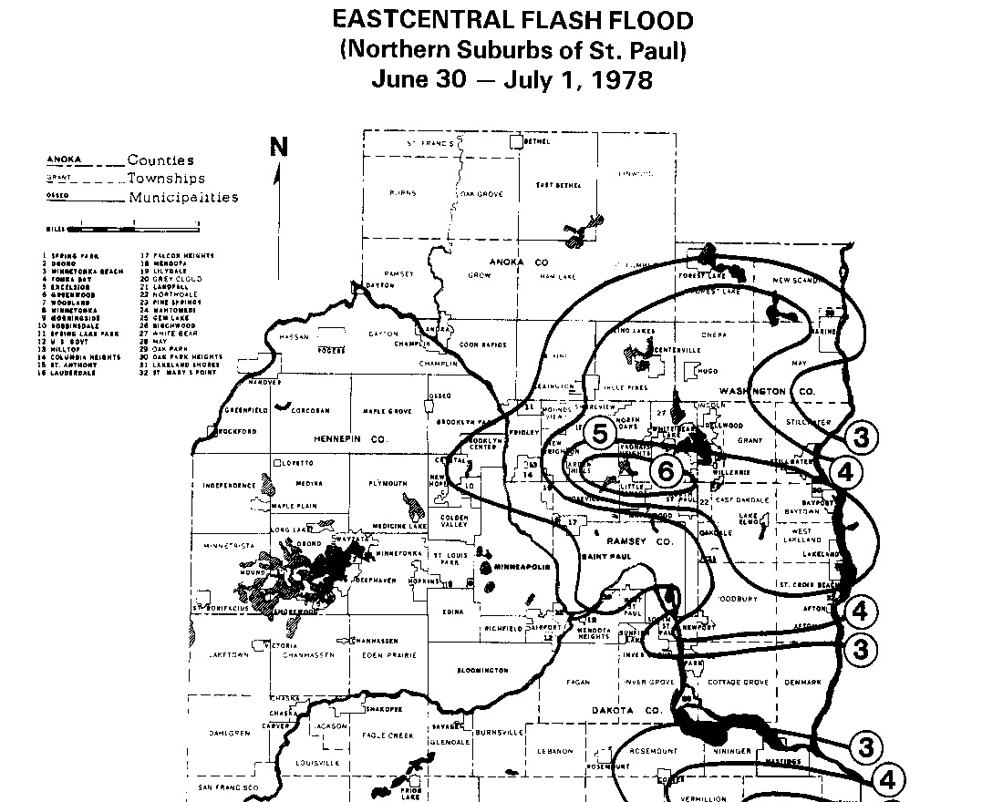
Storm of June 30-July 1, 1978

Slide 15
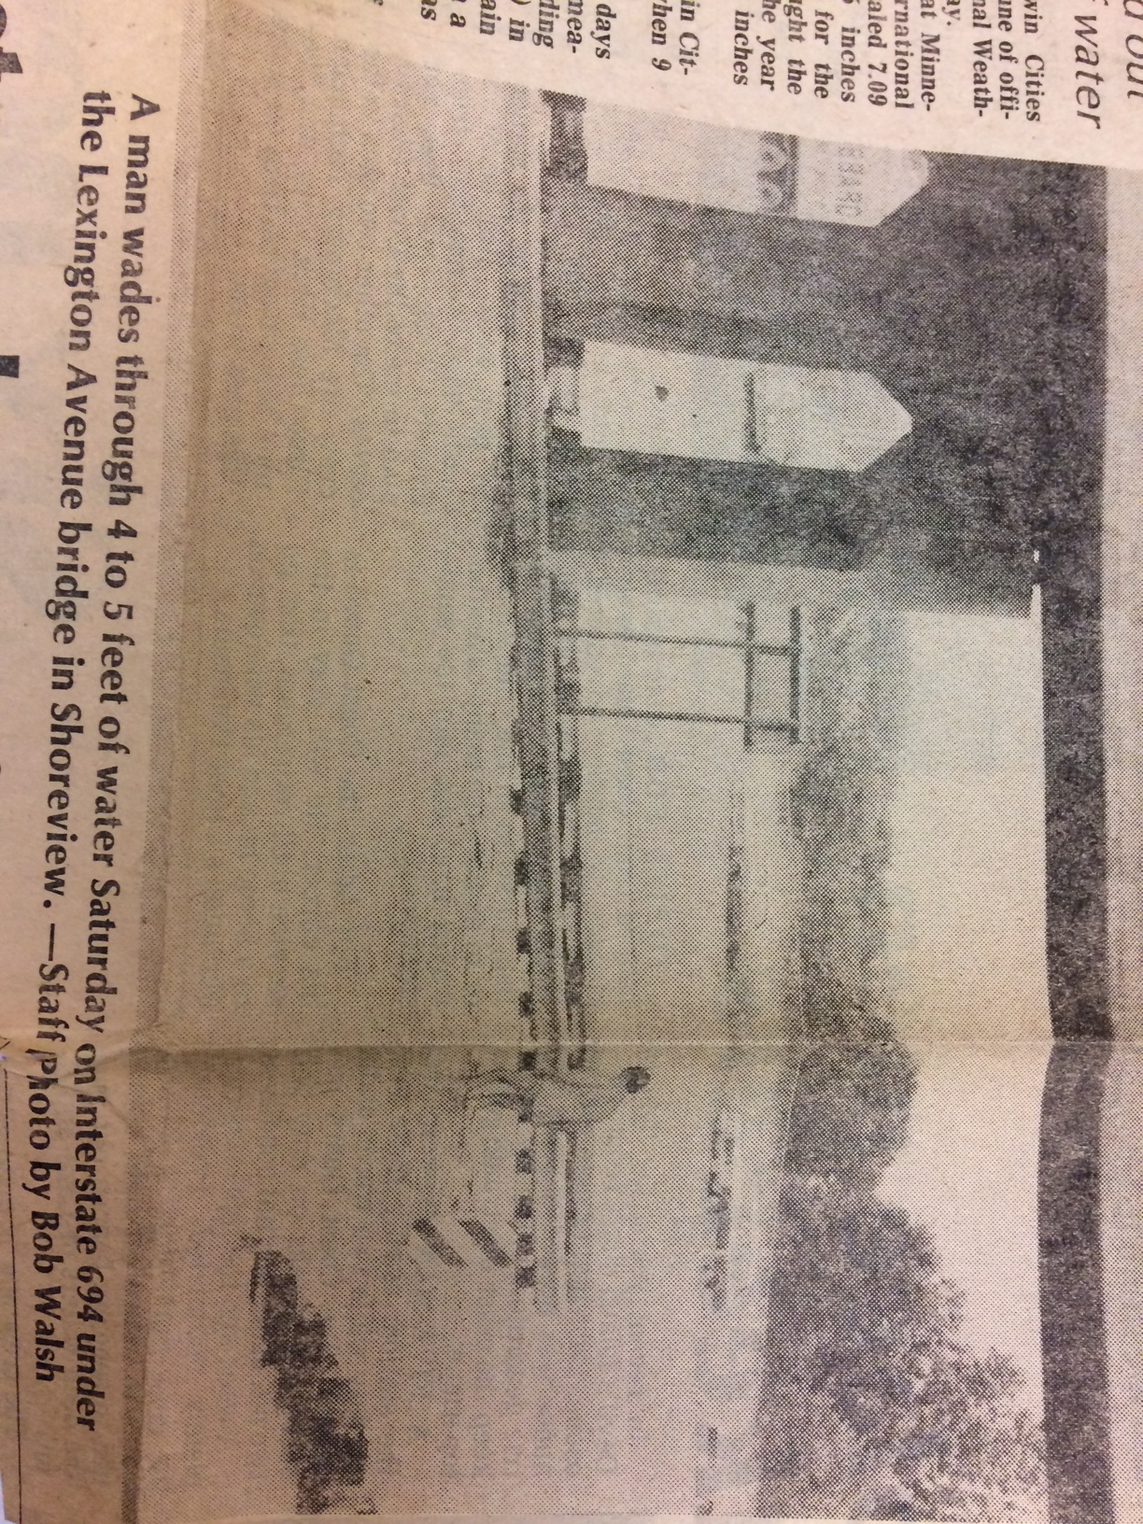
Storm of June 30-July 1, 1978

Slide 16
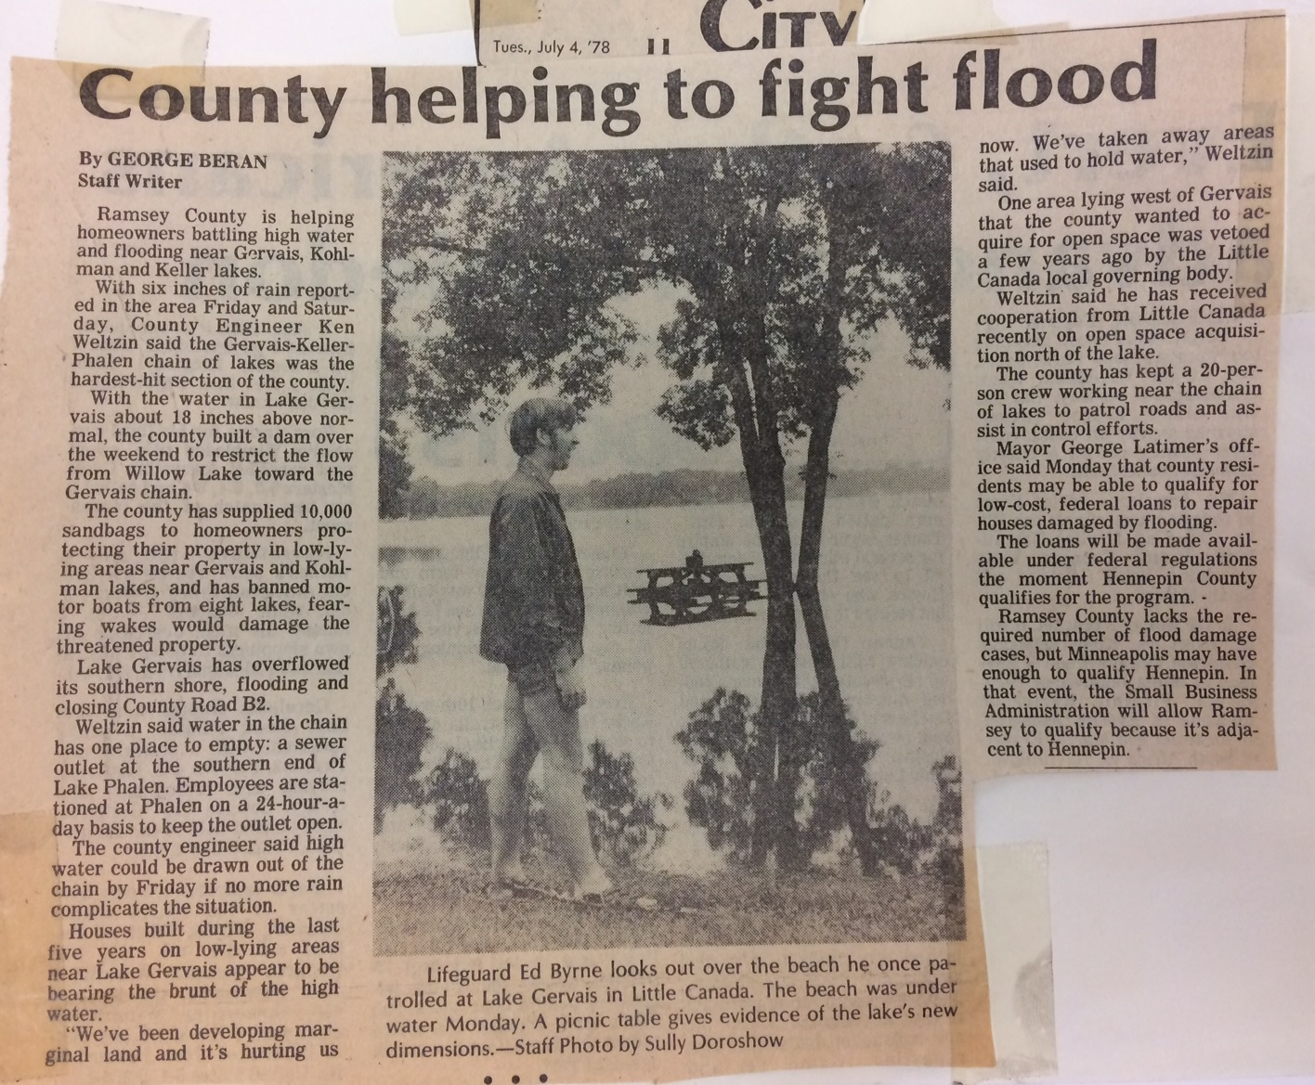
Storm of June 30-July 1, 1978

Slide 17
Storm of June 30-July 1, 1978

Slide 18
MnGage Volunteer Rain Gage Network

Slide 19
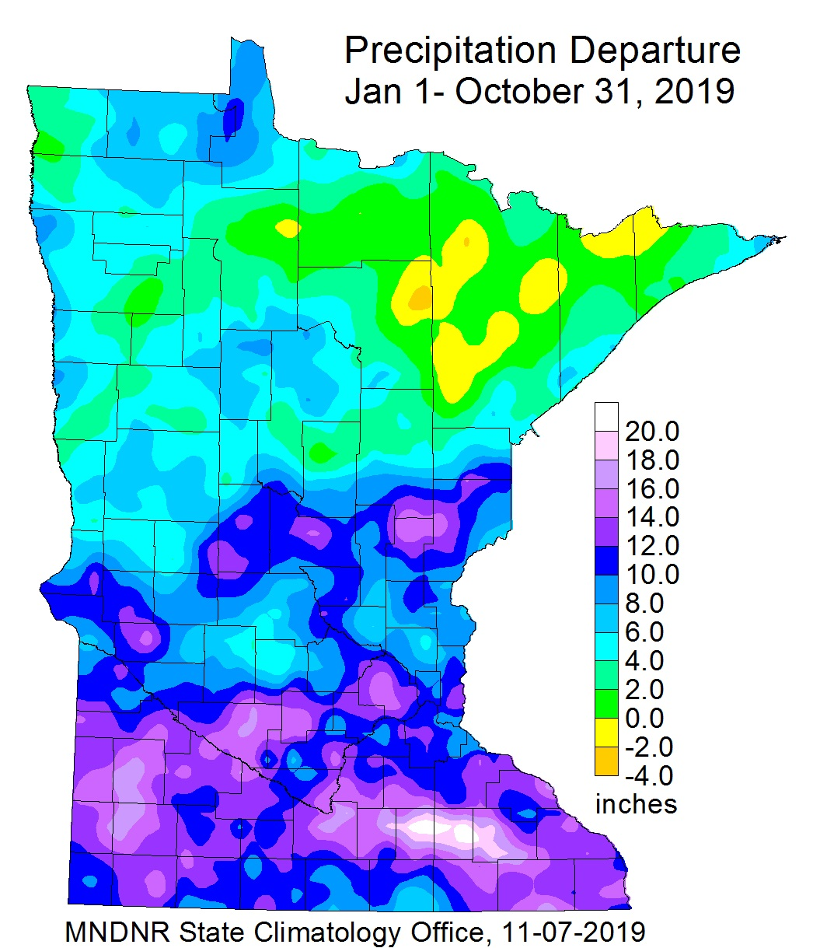
MnGage Volunteer Rain Gage Network

Slide 20
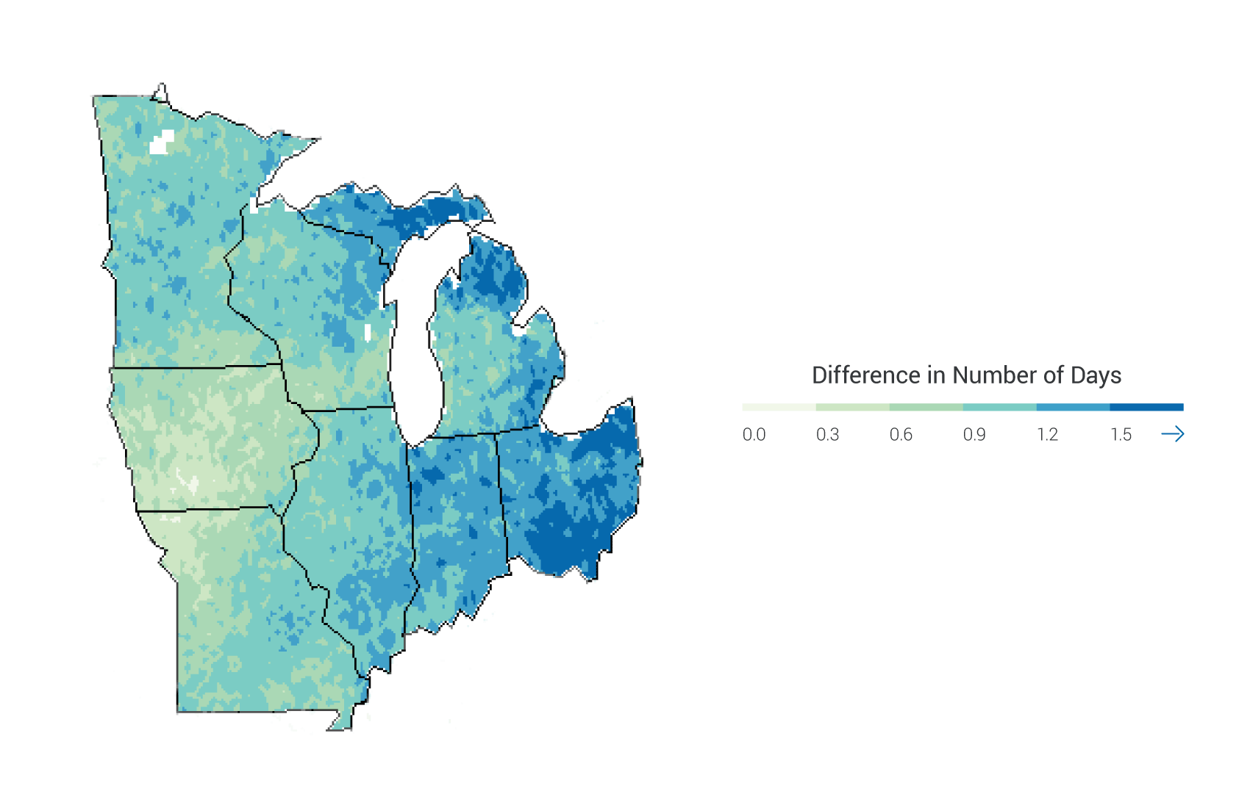
Projections: Continued Increase in “Upper 2 Percentile” Rainfall (1.5 to 2 Inches)
Source: 2014 National Climate Assessment, Midwest Chapter

Slide 21
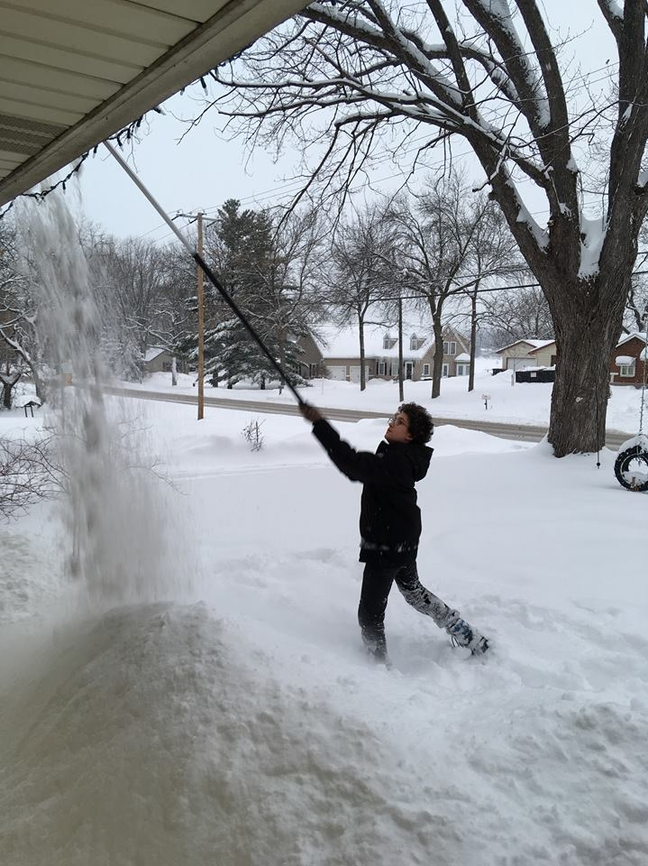
Winter Precipitation

Slide 22
Liquid Precipitation Increasing During Winter

Slide 23
Heavy Snow Increasing: Twin Cities

Slide 24
Snow Depth Declining: Duluth

Slide 25
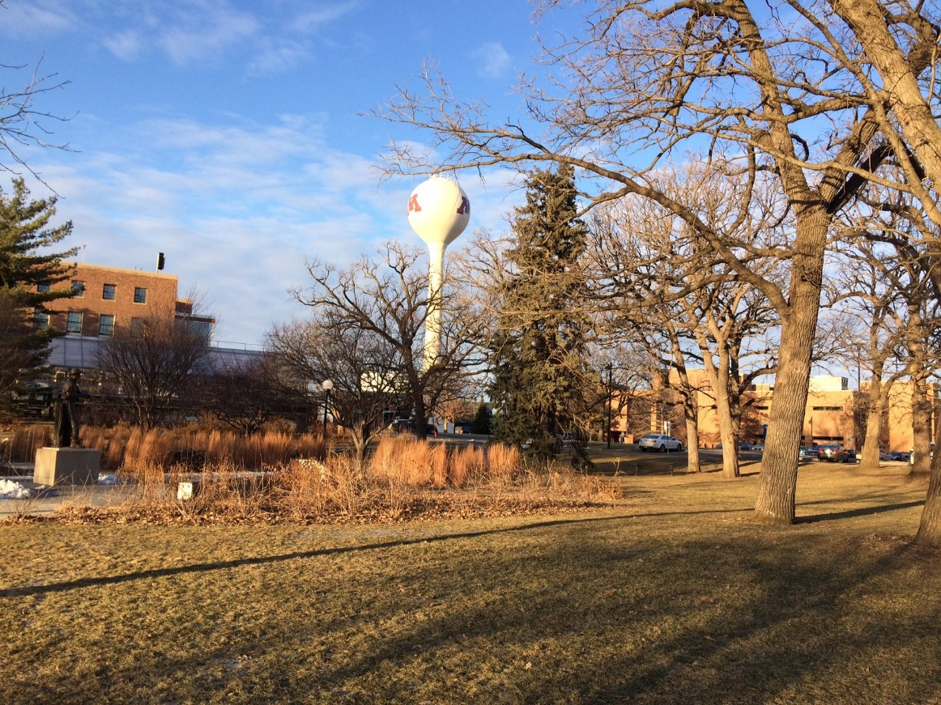
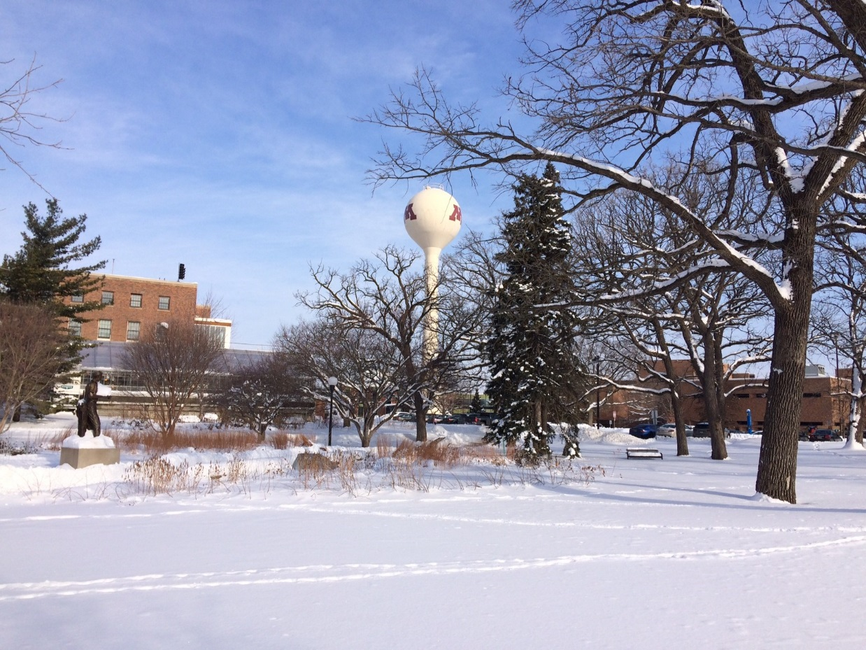
Expect Variability
“Tale of Two Winters”
January 17, 2019
U of M St. Paul
Snow Depth: Zero
February 14, 2019
U of M St. Paul
Snow Depth: 12 in.

Slide 26
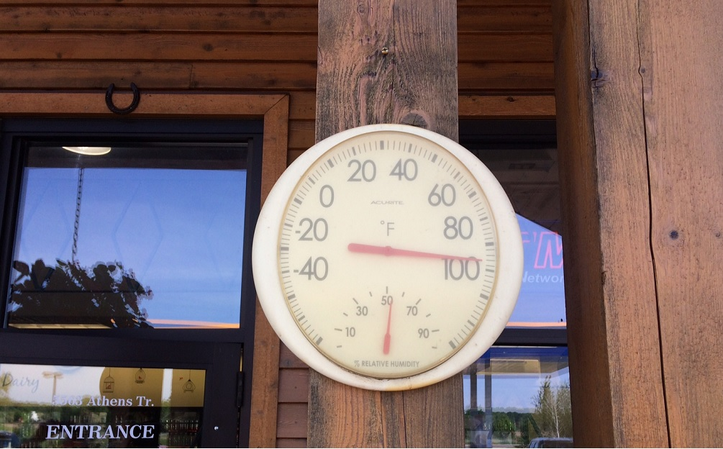
Heat Extremes
Thermometer on May 28, 2018

Slide 27
Winter warming WAY faster than summer
Season | Temperature Metric | Avg. change per decade since 1895 | Avg. change per decade since 1970
Winter (Dec - Feb) | Seasonal Avg. | + 0.40°F | + 1.01°F
Summer (Jun - Aug) | Seasonal Avg. | + 0.13°F | + 0.12°F

Slide 28


Slide 29
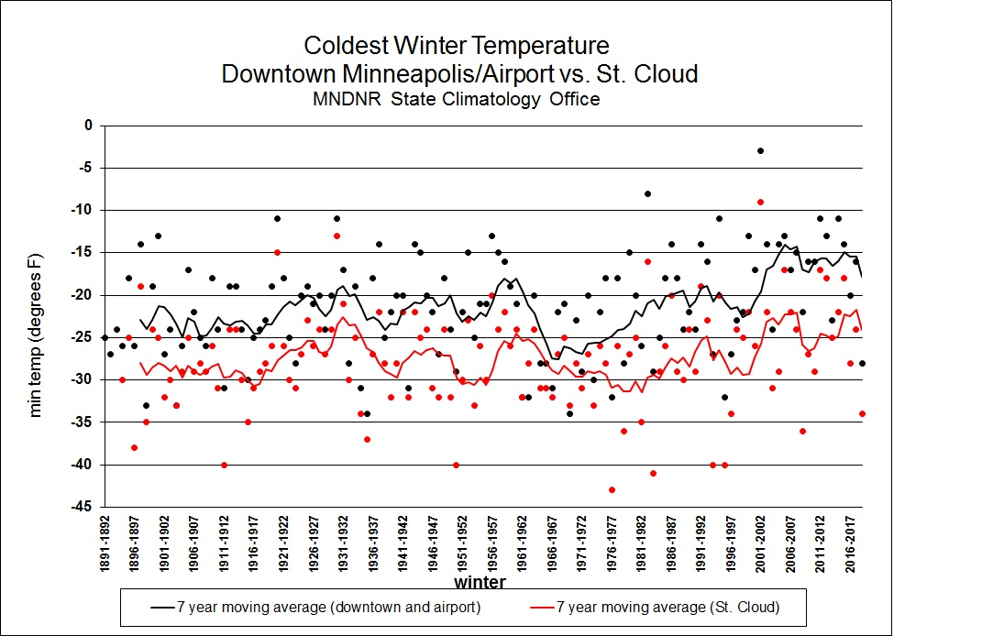
Winters Don’t Get as Cold as They Used To.

Slide 30
Winters Don’t Get as Cold as They Used To.

Slide 31
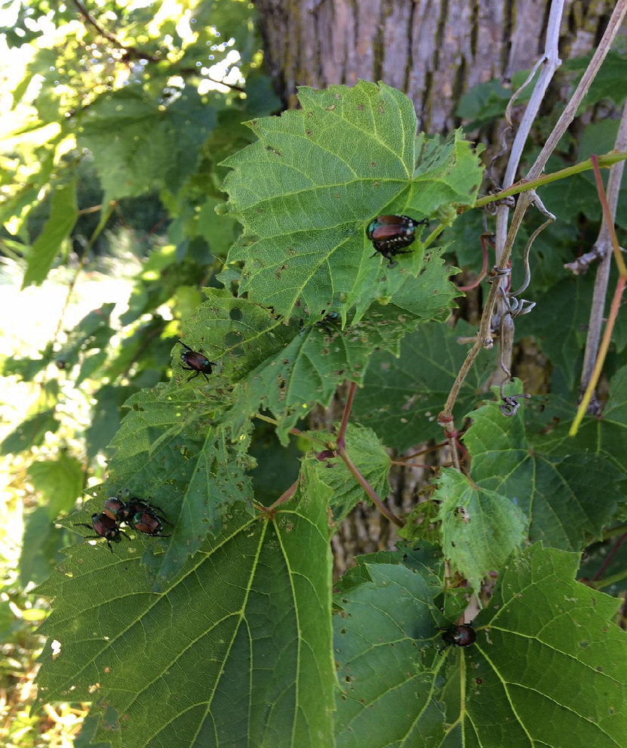
Loss of Extreme Winter Cold
Lethal soil temperature for Japanese Beetle grubs is 15 degrees and die when soil temps are 32 degrees for two months.
Japanese Beetles on Virginia Creeper at Keller Lake, August 2017.
Courtesy: MNDNR State Climatology Office

Slide 32
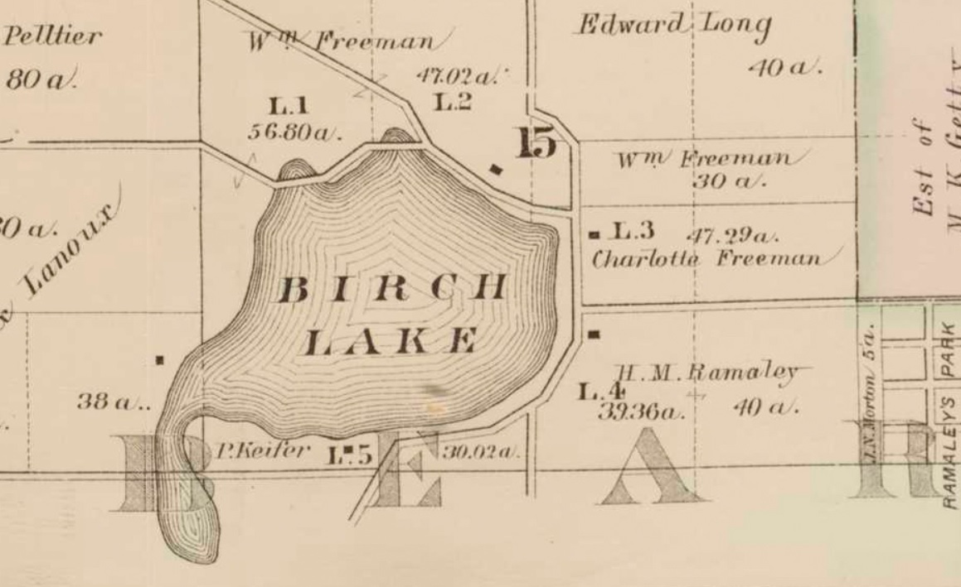
Birch Lake http://geo.lib.umn.edu/collections/digitizedplatbooks/

Slide 33
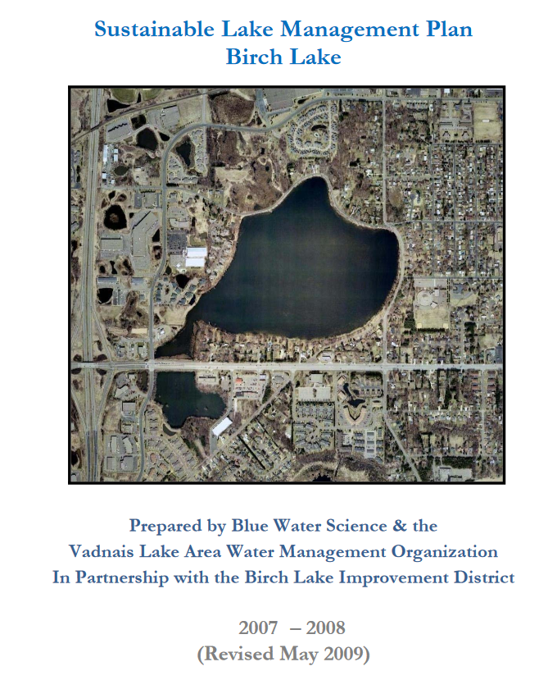
Birch Lake Lake Study from 2008

Slide 34
Birch Lake Lake Study from 2008
…Fluctuation in a lake is expected and if history proves correct, Birch Lake levels will once again rise to its historical average.

Slide 35
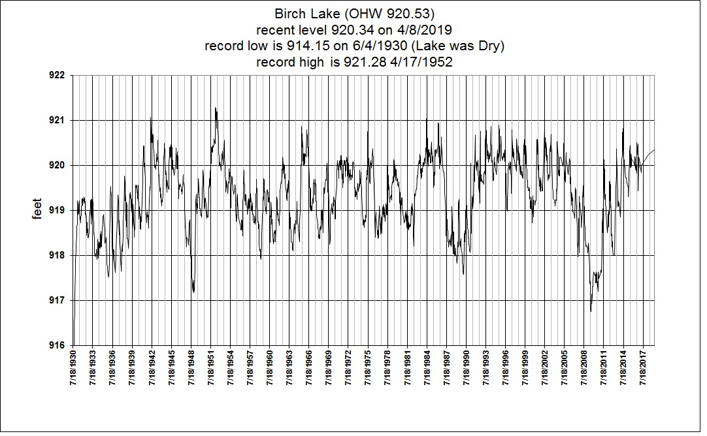
Birch Lake https://www.dnr.state.mn.us/lakefind/index.html

Slide 36
Birch Lake https://www.dnr.state.mn.us/lakefind/index.html

Slide 37
What Can Cities Do?
Support: data collection efforts.
Volunteer Networks: Precipitation and Temperature, Lake Level, Groundwater Monitoring.
Plan: Use existing tools:
NOAA Atlas 14 (for precipitation)
Climate at a Glance and…

Slide 38
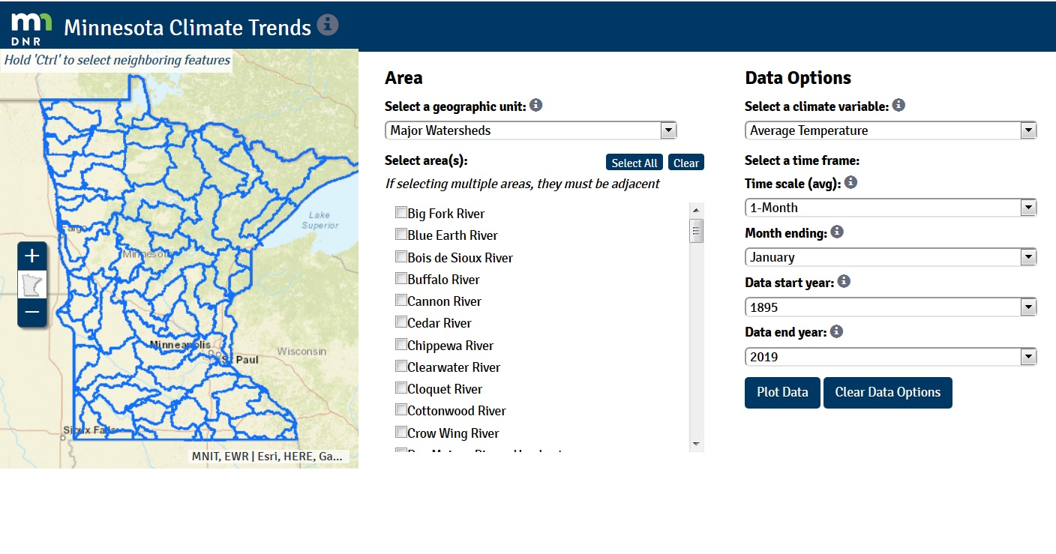
Climate Trends Tool
https://arcgis.dnr.state.mn.us/ewr/climatetrends/
Or Google: mn climate trends tool dnr

Slide 39
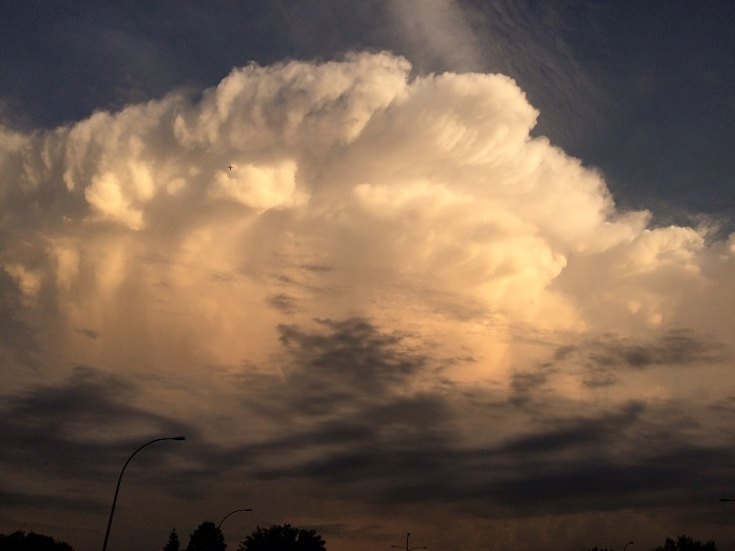
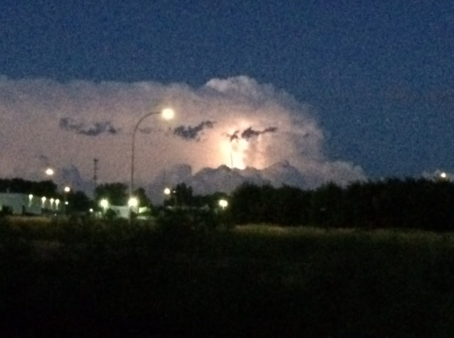
Any questions?
Pete Boulay
Peter.Boulay@state.mn.us
651-296-4214
Storms of 2017
Courtesy: Minnesota State Climatology Office

