Slide 1
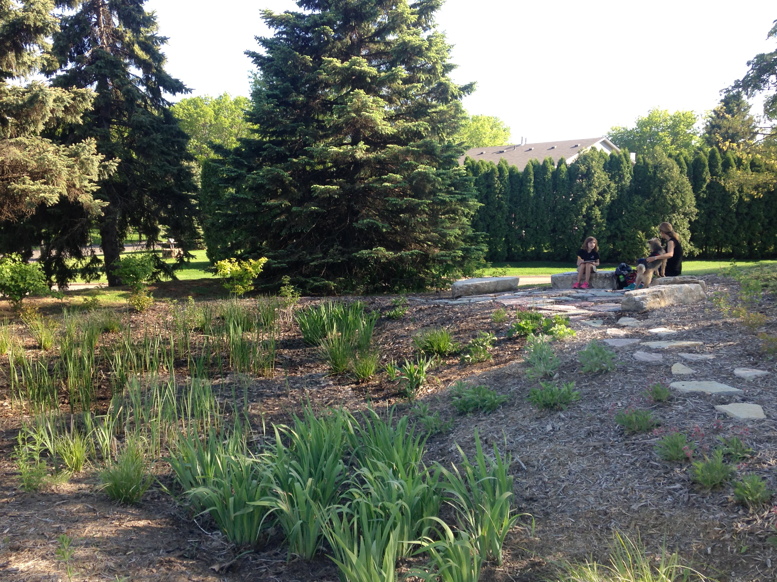

Raingarden
Maintenance
Tips to keep your raingarden thriving
June 13th, 2018
Nick Voss
Education & Outreach Coordinator
Guests: Gina Schmidt & Suzanne Ryan
VLAWMO
Notes:
Draft template for modification. It is assumed that the target audience is people who own functional raingardens (already designed and installed).

Slide 2
Outline
Why maintenance?
Common problems and solutions
Seasonal strategies
Activity
Raingarden Q & A
Resources
Notes:
Draft template for modification. It is assumed that the target audience is people who own functional raingardens (already designed and installed).

Slide 3
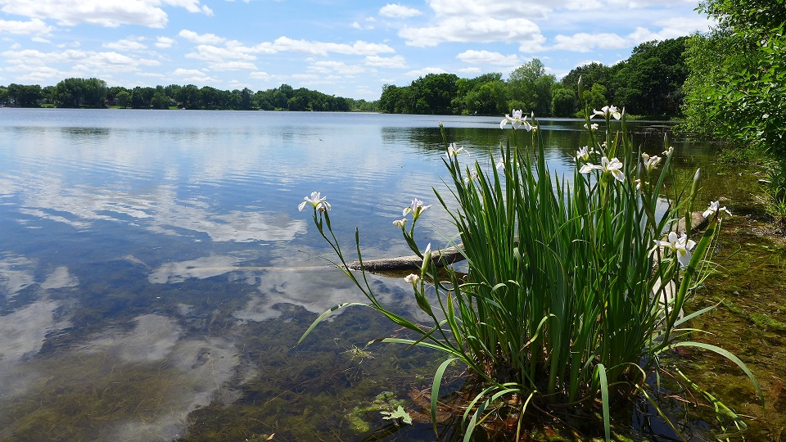
Why maintenance?
“Garden” is a noun and a verb

Slide 4
Why maintenance?
VLAWMO Raingarden Stats:
Annual Volume Reduction:
Annual Particulate P
Annual
Dissolved P
Annual Suspended Solids
10.23
4.6
3.7
1,537.7
Acre/ft
lbs
lbs
lbs
3,334,661 Gallons

Slide 5
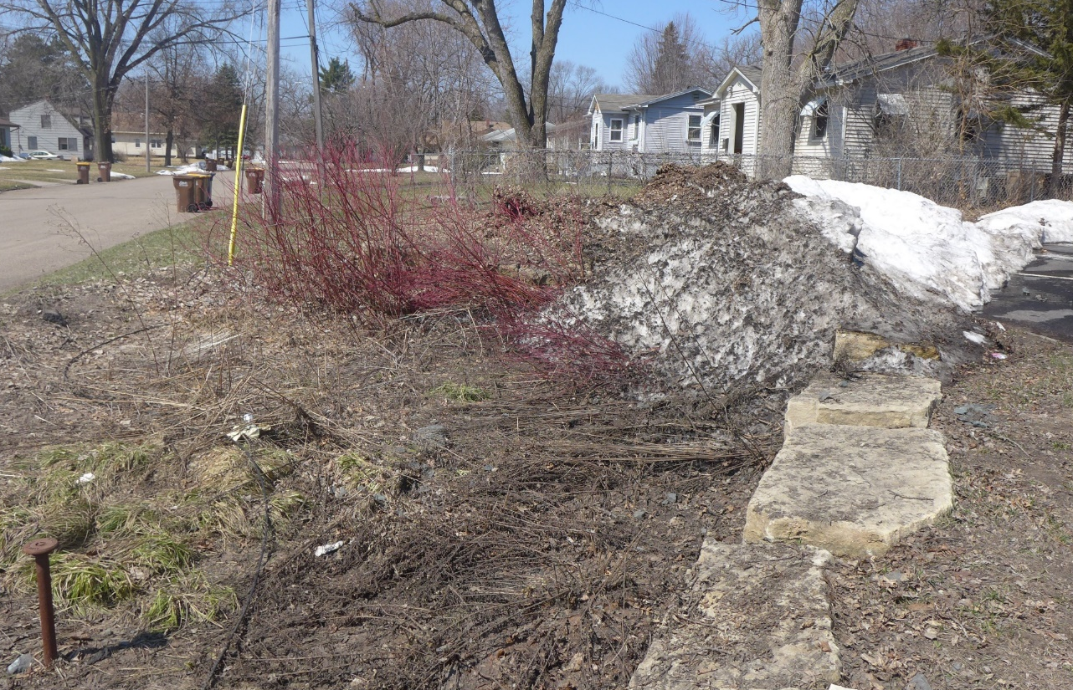
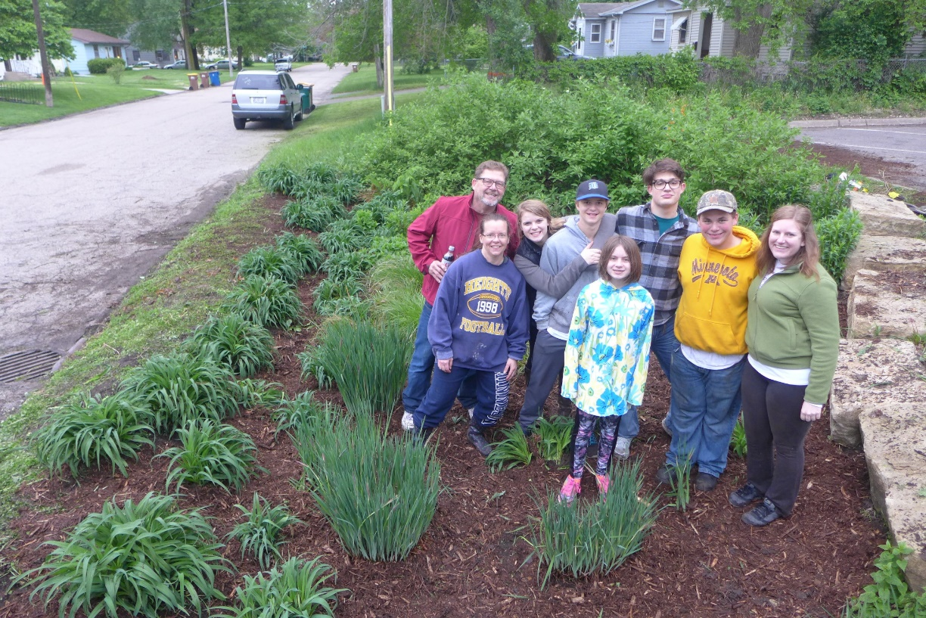
Why maintenance?

Slide 6
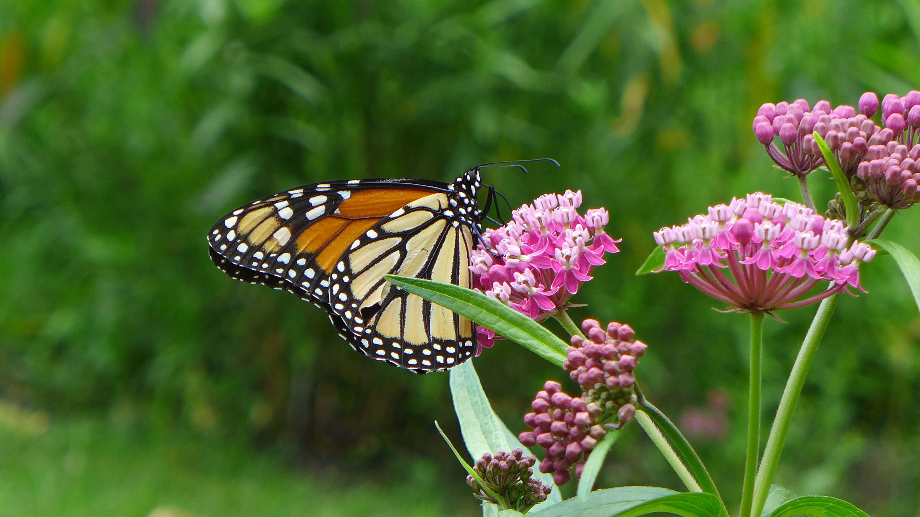
Common Problems and Solutions
Aesthetics
Weeding:
Garden confusion: simplify planting, plant in massings.
Plugs die: Water plugs frequently (1”/week)
Too many weeds: Keep mulch at 3” for a few years. Mulch breaks down 1.5”/yr
Maintain edging, mow perimeters away from garden
Extreme cases: start over
Clear mulch and lay fabric or plastic around plants
Dig out best plants, excavate or glyphosphate
Notes:
Make it easy to tell planted vs. sneak in
Mulch keeps out weeds, prevents erosion, amends soil

Slide 7
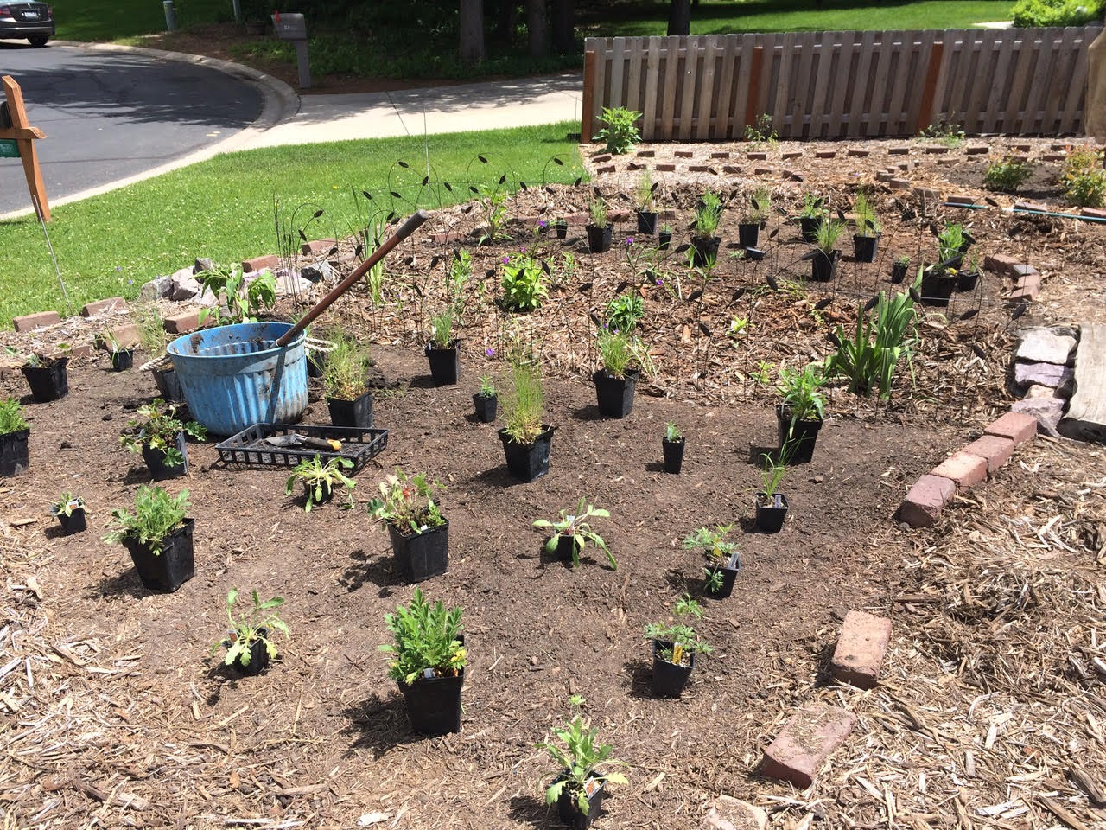
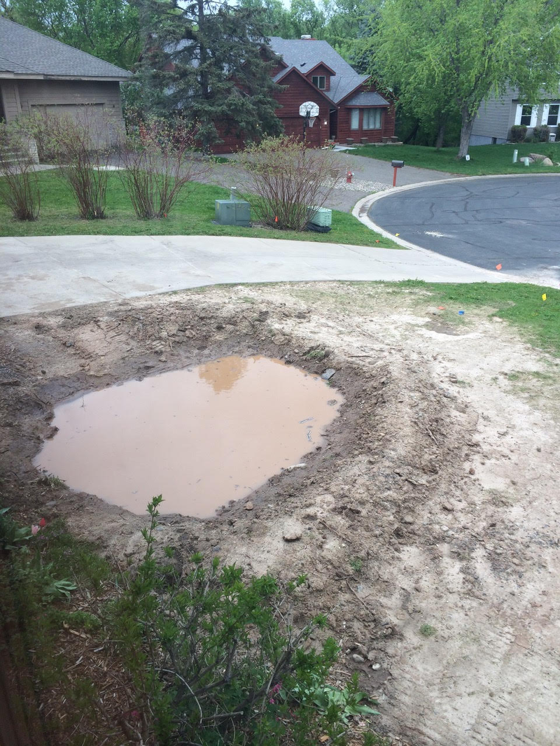
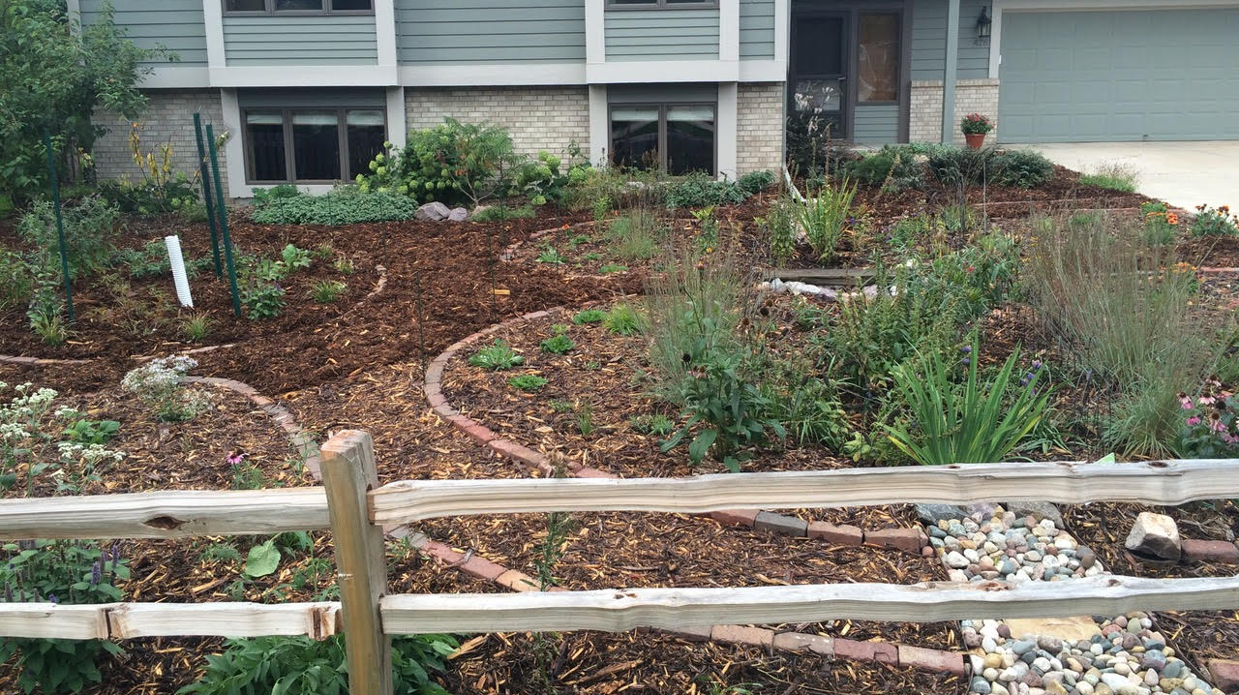
Common Problems and Solutions
Notes:
Make it easy to tell planted vs. sneak in
Mulch keeps out weeds, prevents erosion, amends soil
Gina’s example: Adaptation to yard needs/responses, 2nd raingarden addition, 2 years of observation/actions

Slide 8
Common Problems and Solutions
Function
Too much sediment & debris:
Ongoing, small increment cleaning
Experiment with structures
Rainguardian
Flagstone, trap rock
Signs of red alert!
Raingarden or parts of raingarden no longer infiltrate
Water takes longer than 48 hours to infiltrate
Weed trees take over (Boxelder, green ash, etc.)
Can’t locate original plants
Notes:
Make it easy to tell planted vs. sneak in
Mulch keeps out weeds, prevents erosion, amends soil

Slide 9
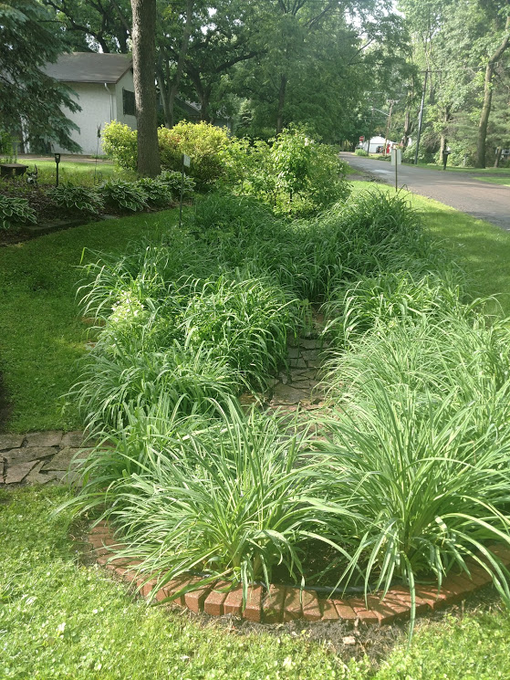
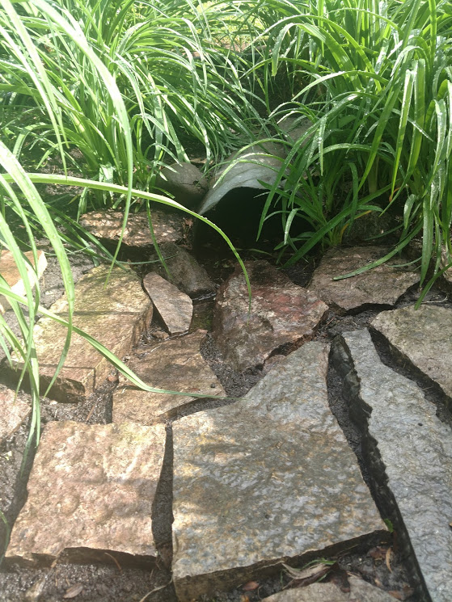
Common Problems and Solutions
Notes:
Make it easy to tell planted vs. sneak in
Mulch keeps out weeds, prevents erosion, amends soil
Suzanne’s example: Poor drainage, planting lilies, a raingarden, a sidewalk pipe, then attending a VLAWMO workshop. Yard consisted of poor construction soil, compost improvements.

Slide 10
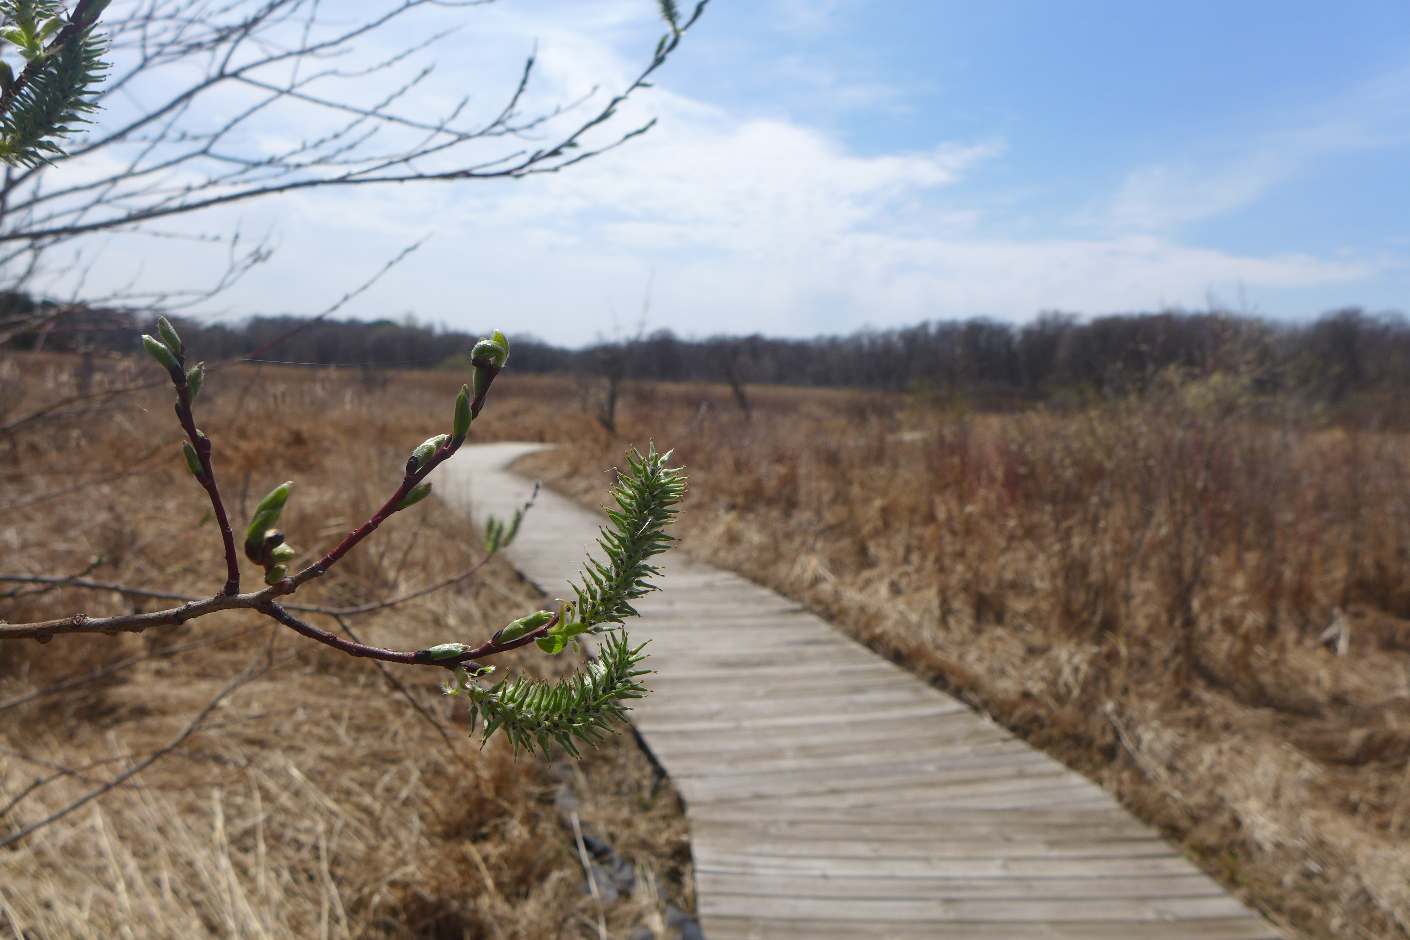
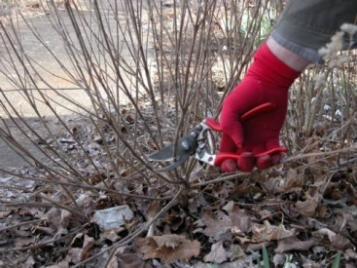
Seasonal Strategies
Early Spring
Cut back winter stand
Cut back within a few inches of the ground
Flag good plants in the fall to easily decipher them from Spring weeds

Slide 11
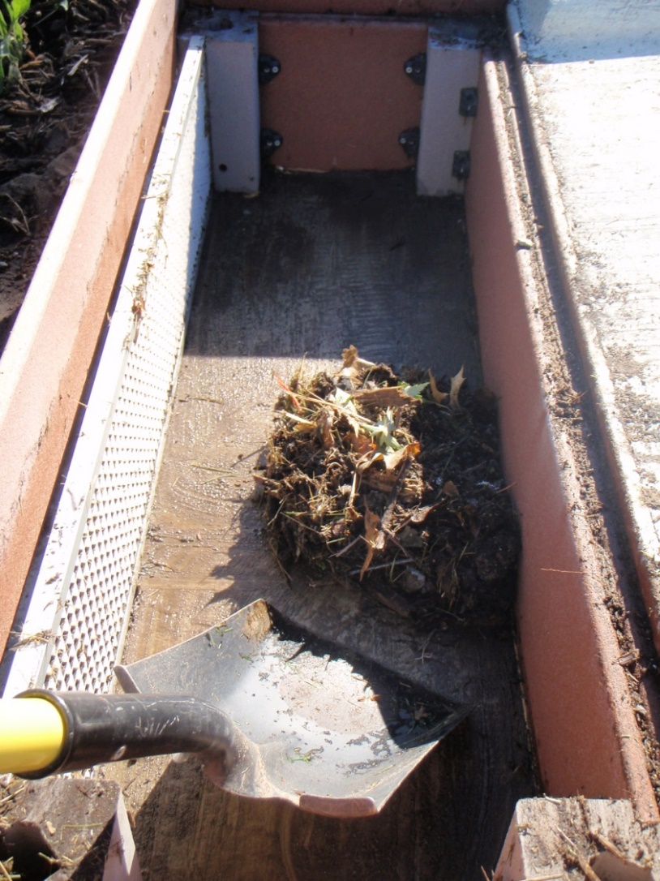
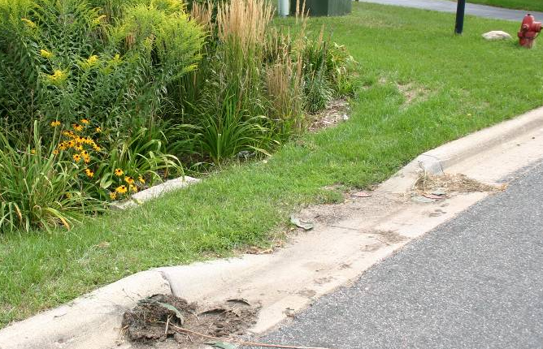
Seasonal Strategies
Early Spring
Remove sediment and litter
Trash, dirt, salt, sand from winter
Dispose as trash
No shortcuts: disposing in diches, etc.
Key asset to water quality

Slide 12
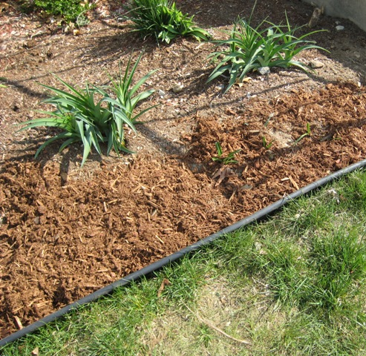
Seasonal Strategies
Early Spring
Aesthetics
Weeding:
Simplify planting, plant in massings. Keep mulch at 3” for a few years. Mulch breaks down 1.5”/yr
Keep a list of what should be there
Maintain edging, mow perimeters away from garden
Plugs can dry out, trees establish quick
Weeds and grasses start small
Annual: pull before they seed
Perennial: pull tap roots, dig out running roots
Gaps mean weeds: new plants
Keep up on weeds before they’re terrible
Pull grasses after rain
Extreme cases: start over
Dig out best plants, excavate or glyphosphate
Clear mulch and lay black plastic around plants
Weeding and edging
Dig out cool season grasses
Delineate garden, mow perimeter
Replenish 3” of mulch
Keep a list of what should be there
Fill gaps
Annual weeds: pull before they seed.
Perennial: Pull tap roots, dig out running roots
Keep up gradually before it gets difficult
Pull grasses after rain

Slide 13
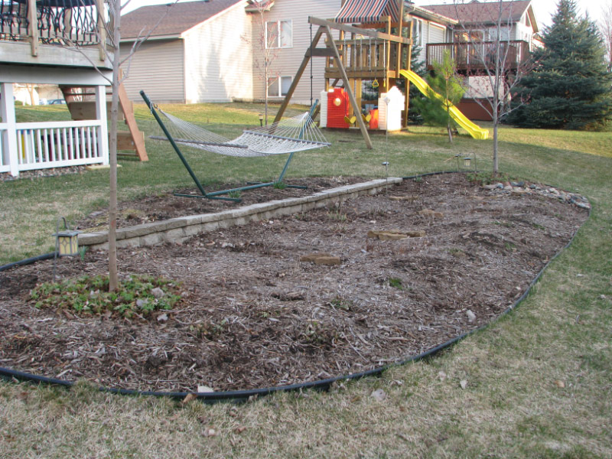
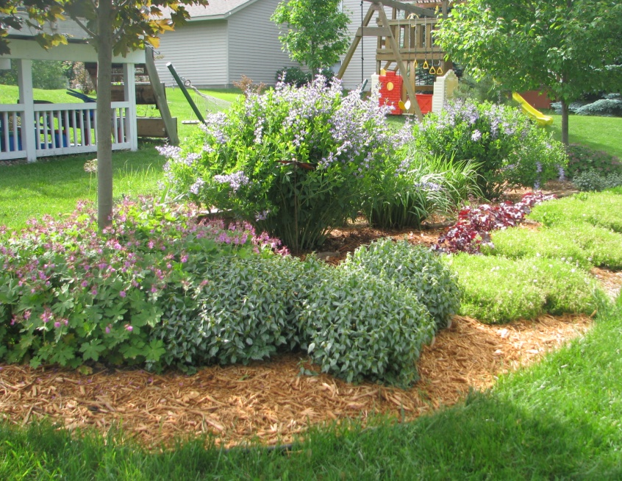
Seasonal Strategies
Early Spring
Aesthetics
Weeding:
Simplify planting, plant in massings. Keep mulch at 3” for a few years. Mulch breaks down 1.5”/yr
Keep a list of what should be there
Maintain edging, mow perimeters away from garden
Plugs can dry out, trees establish quick
Weeds and grasses start small
Annual: pull before they seed
Perennial: pull tap roots, dig out running roots
Gaps mean weeds: new plants
Keep up on weeds before they’re terrible
Pull grasses after rain
Extreme cases: start over
Dig out best plants, excavate or glyphosphate
Clear mulch and lay black plastic around plants
Weeding and edging

Slide 14
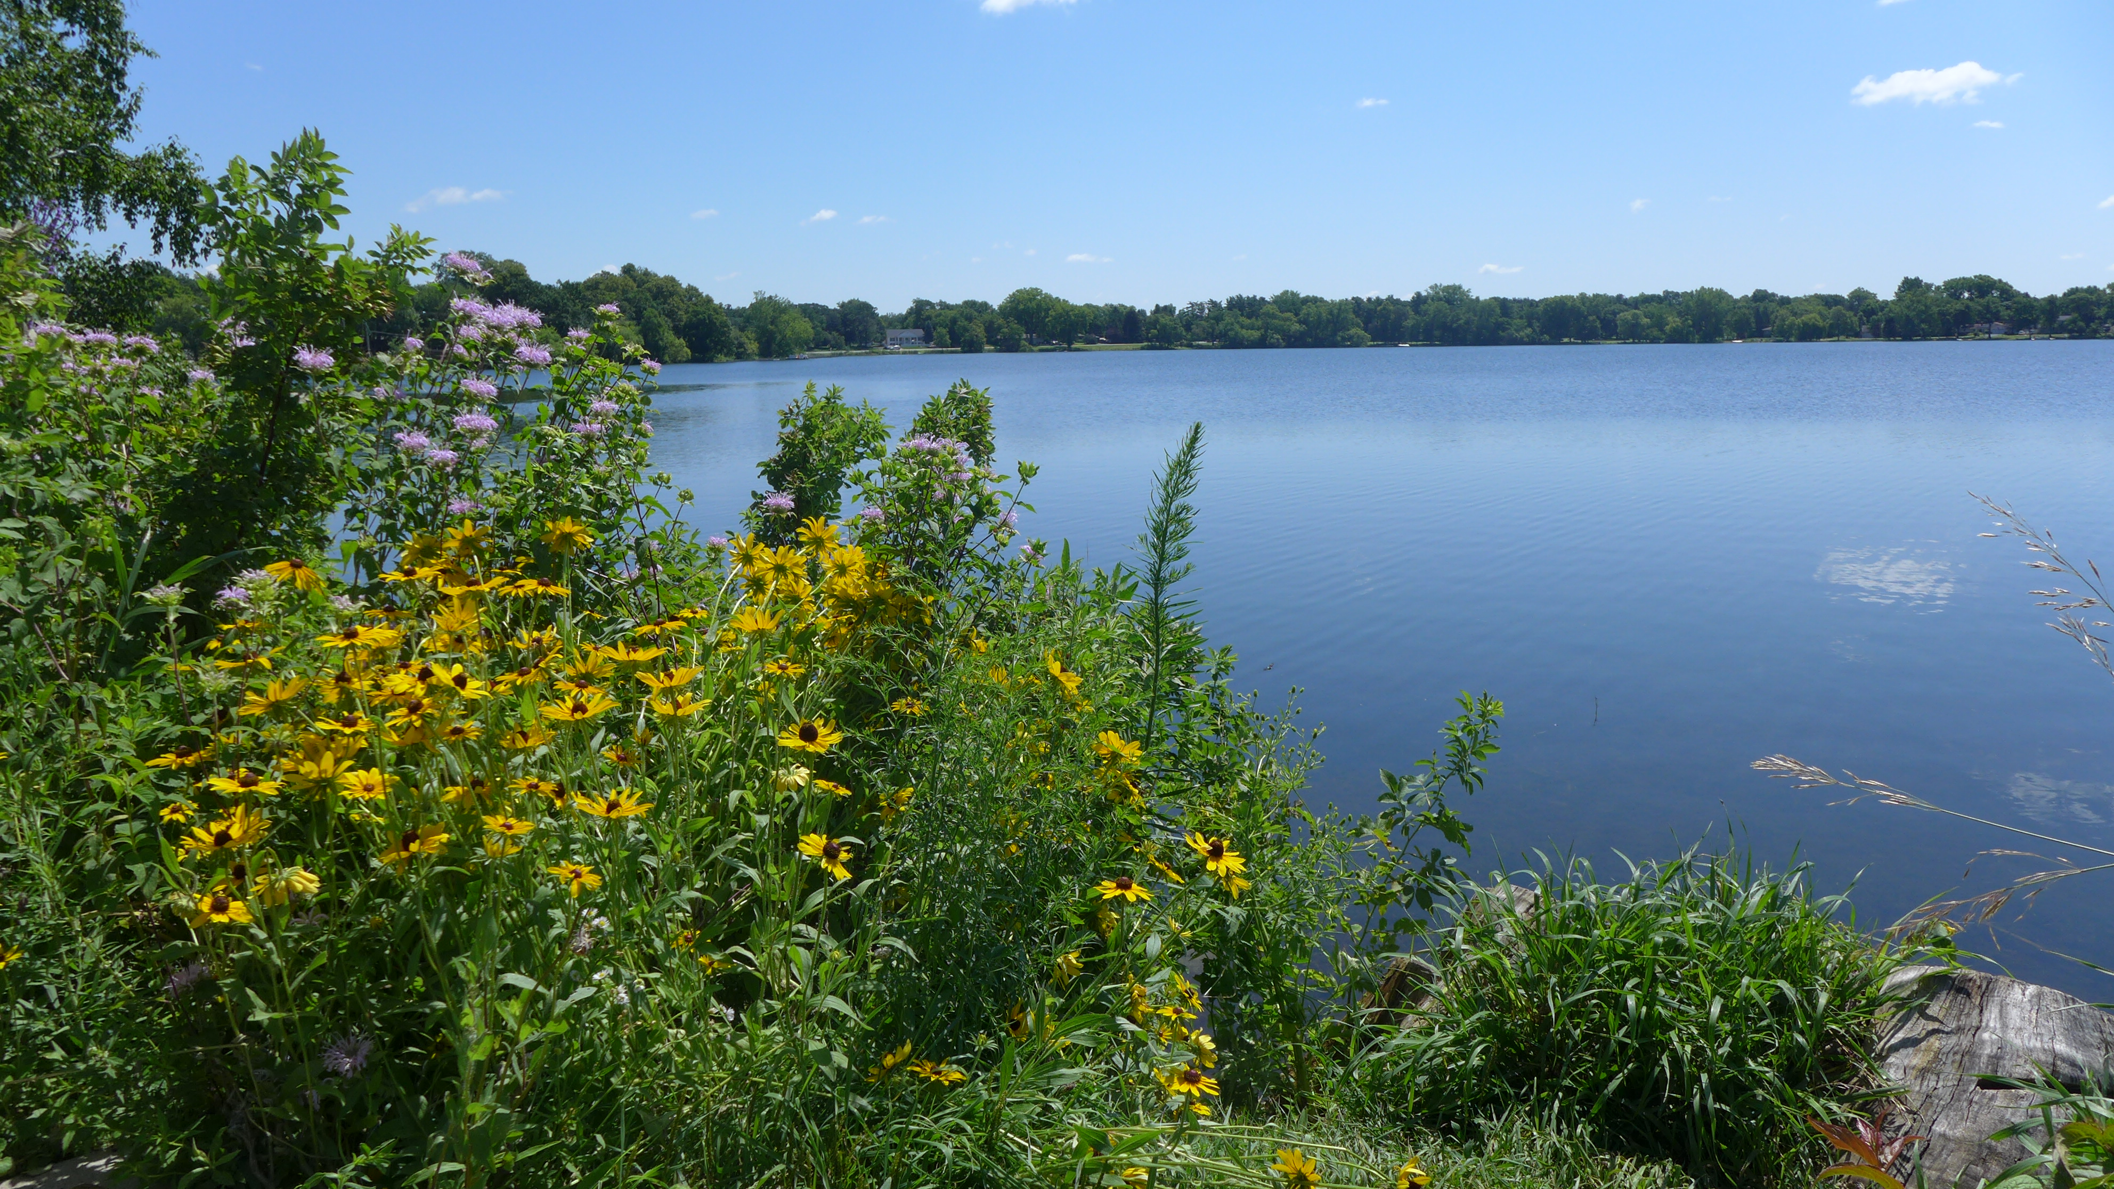
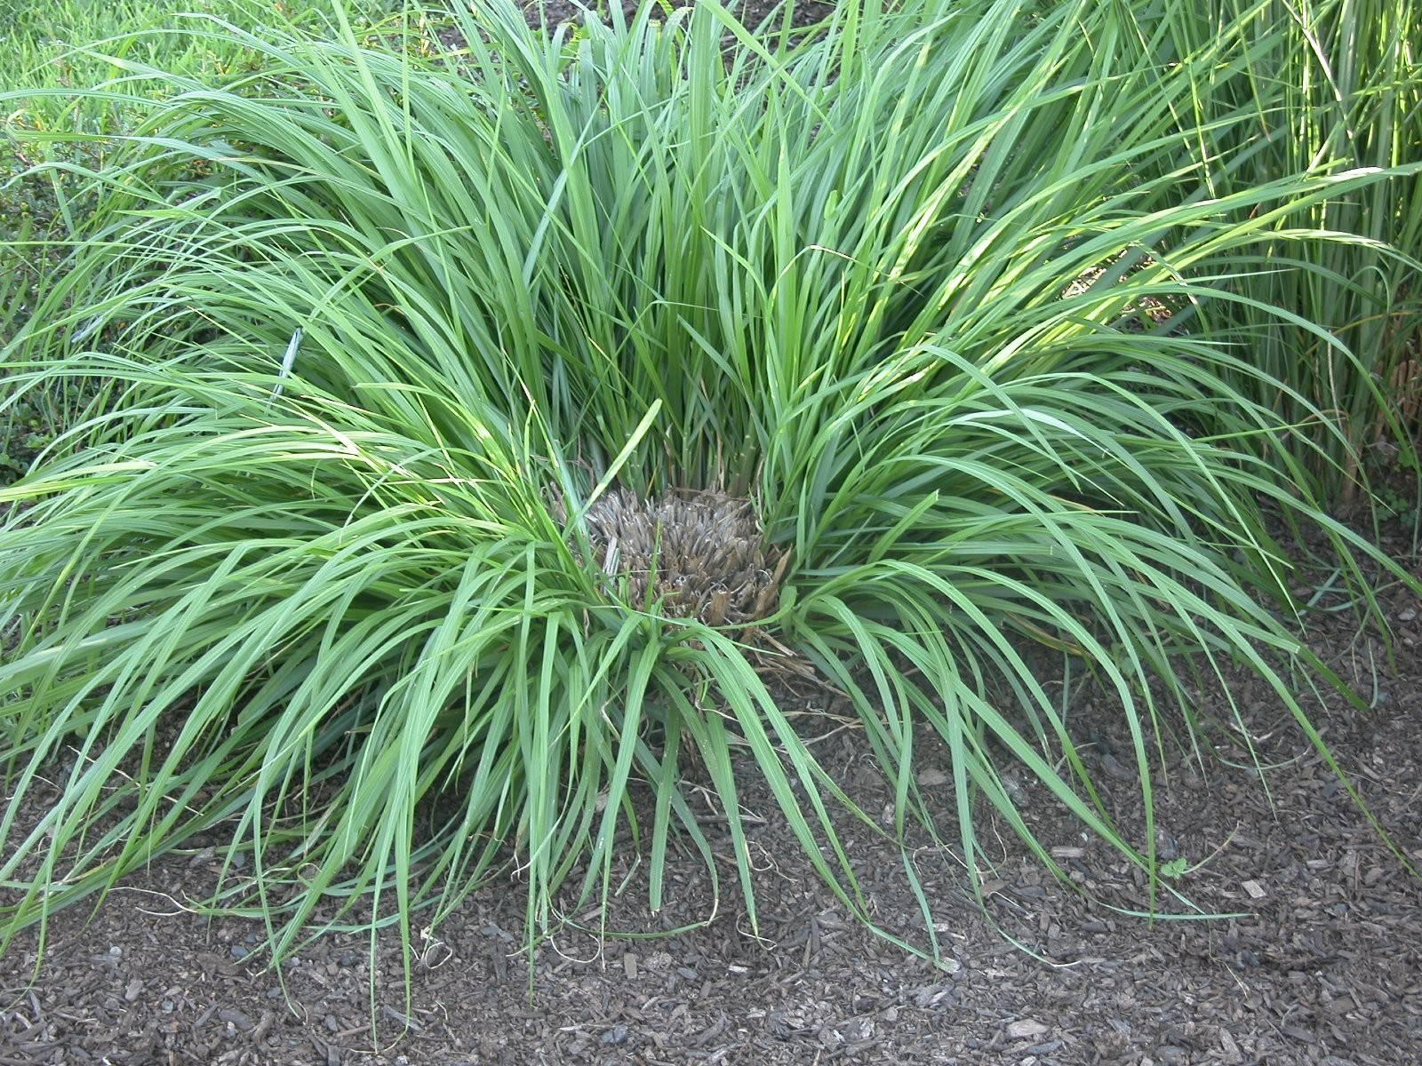
Seasonal Strategies
Mid/late Spring
Divide plants
If grown 2-3 times their size in 3 yrs
Outgrowing their space
“Doughnut” plants

Slide 15
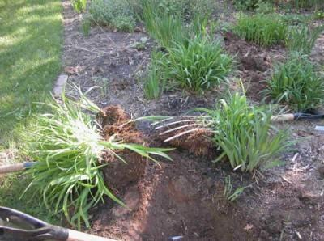
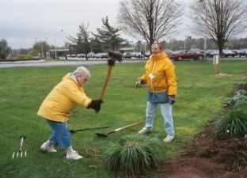
Seasonal Strategies
Mid/late Spring
Divide plants
When plants are actively growing, leaf growth still small
Dig and remove entire plant
Split by pulling apart by hand or with potato forks
Replant, relocate, or share divided plants

Slide 16
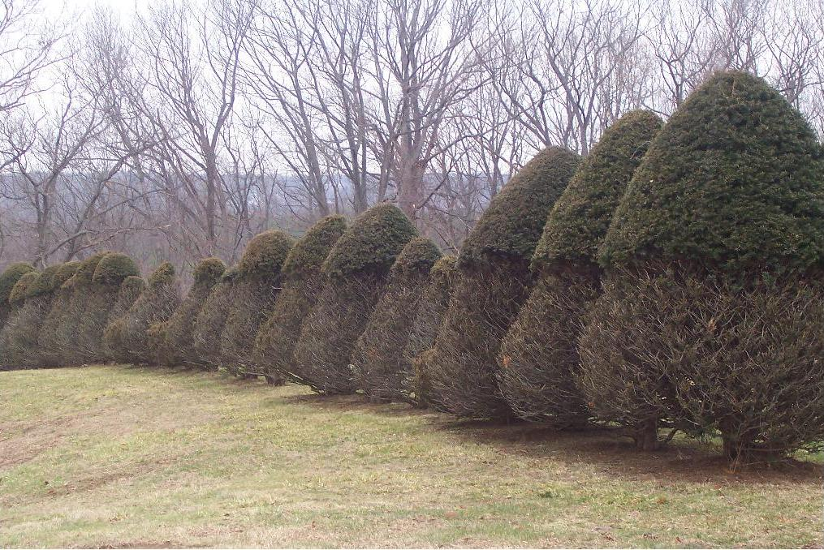
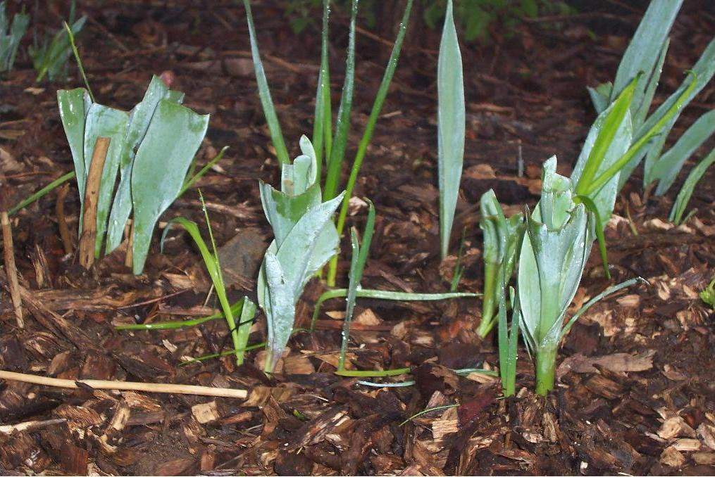
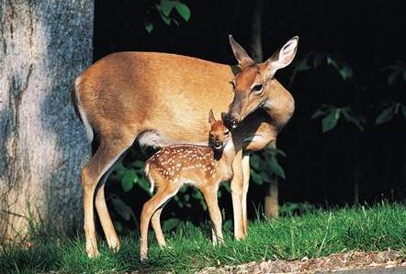
Seasonal Strategies
Mid/late Spring
Deer:
Bad Bambi!

Slide 17
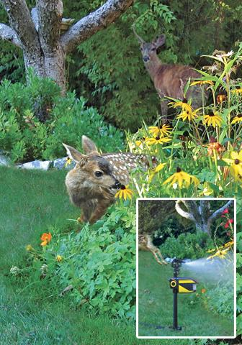
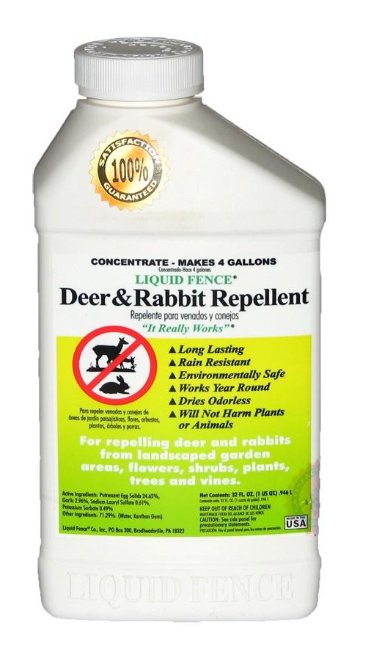
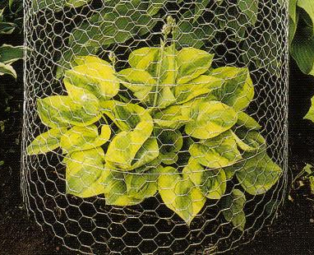
Seasonal Strategies
Mid/late Spring
Deer:
Bad Bambi!

Slide 18
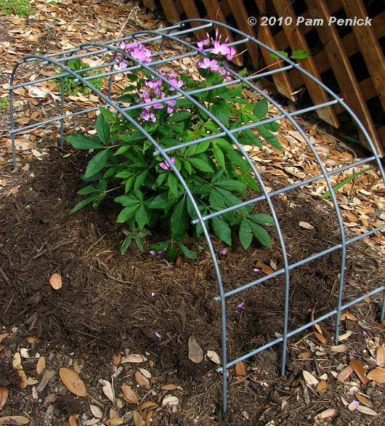
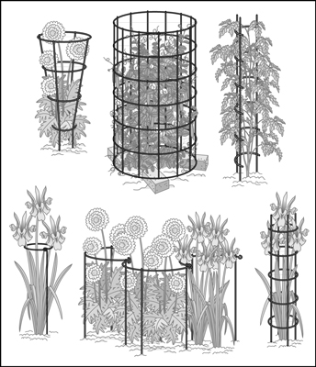
Seasonal Strategies
Mid/late Spring
Plant Staking

Slide 19
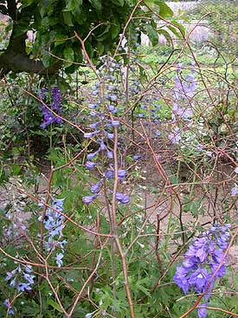
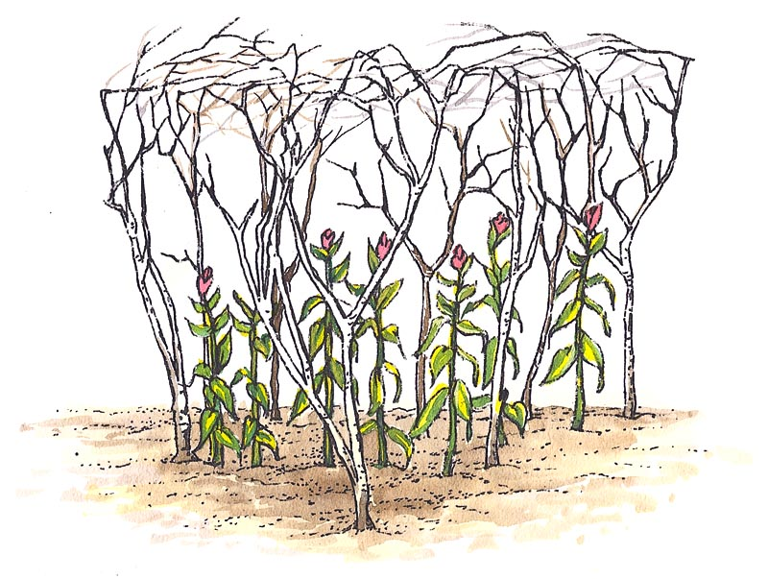
Seasonal Strategies
Mid/late Spring
Plant Staking

Slide 20
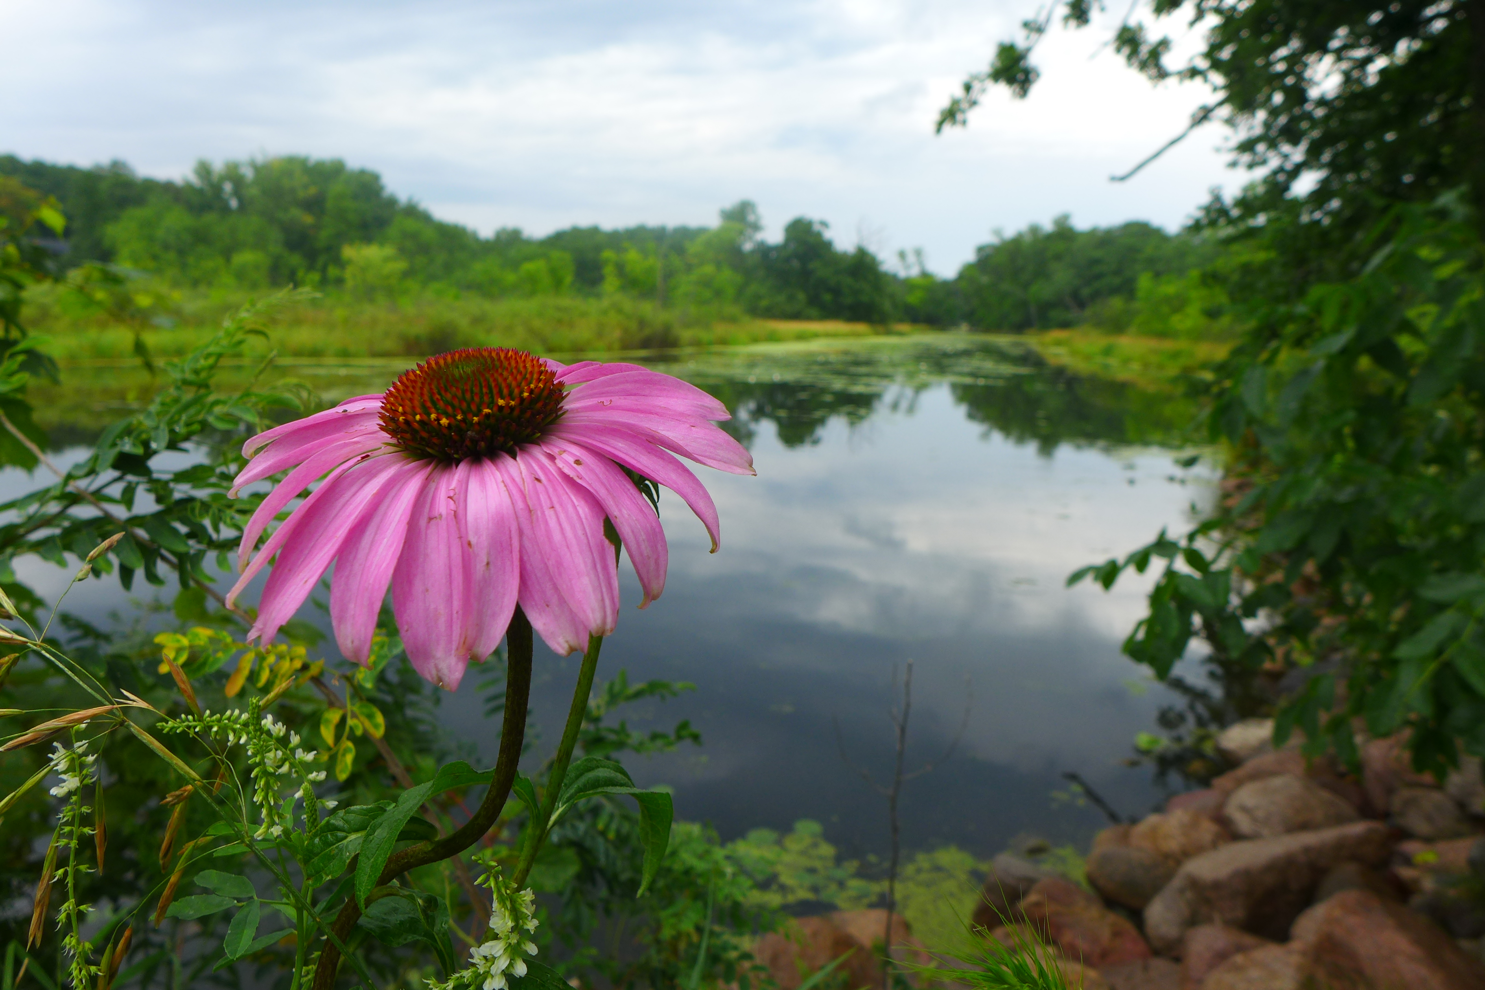
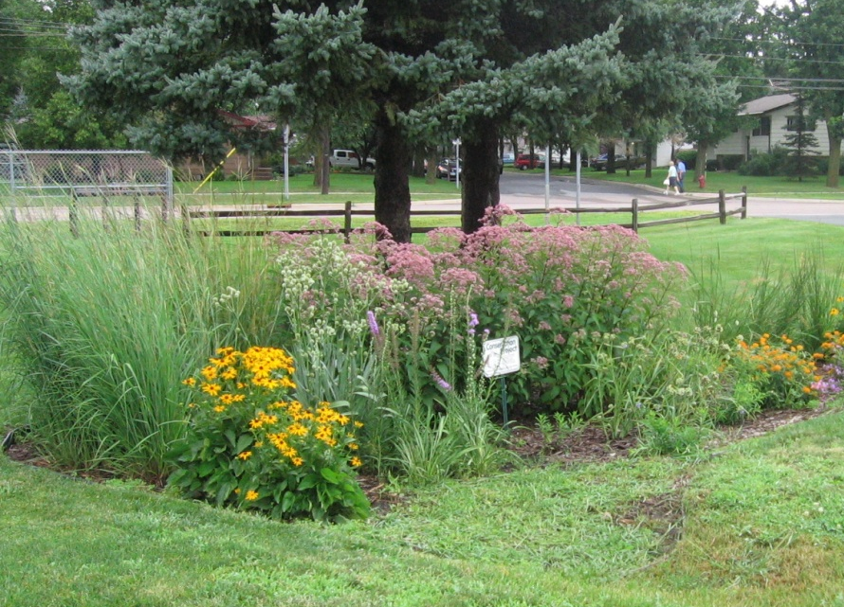
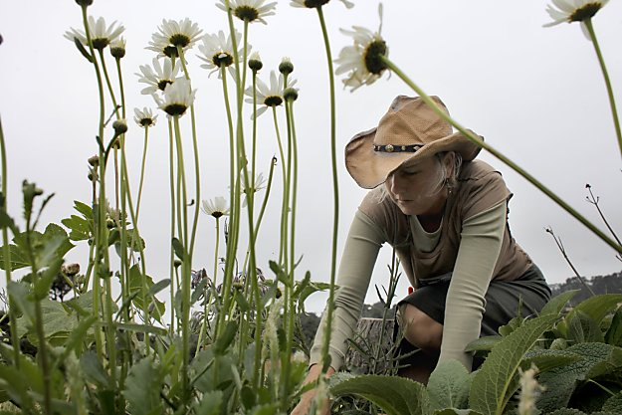
Seasonal Strategies
Early/Mid Summer
Weeding
Pull/spot spray, and re-mulch areas that are getting over run with weeds.
Spraying Photo

Slide 21
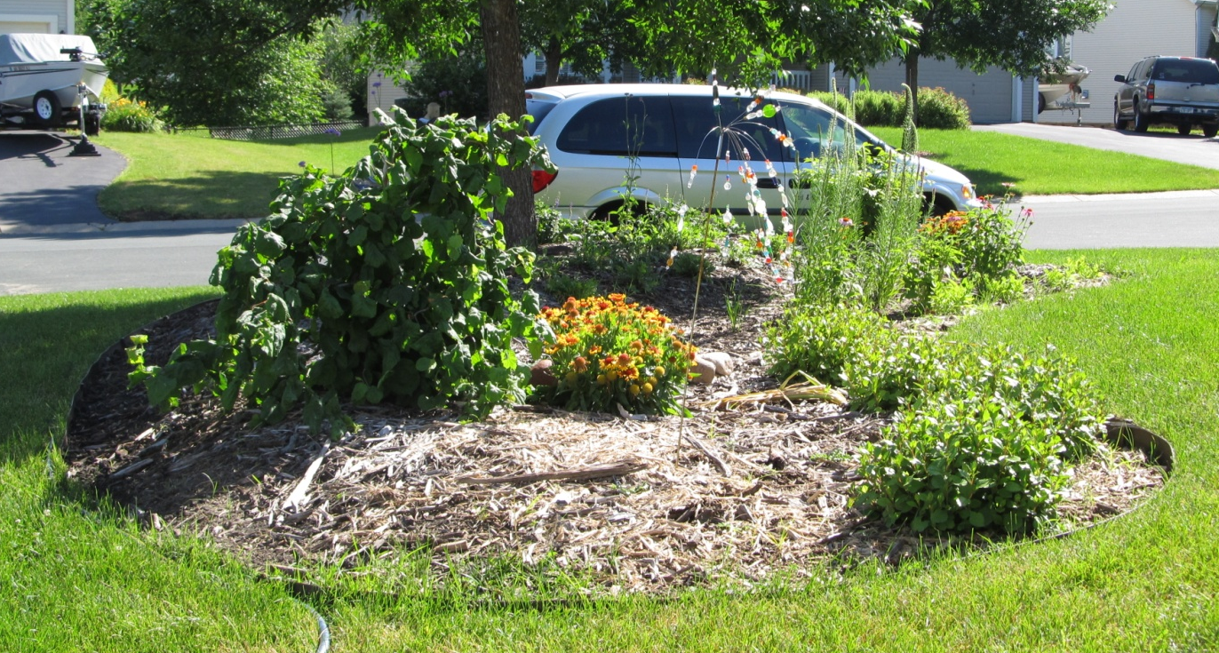
Seasonal Strategies
Early/Mid Summer
Plant Replacement
Replace areas where plants are sparse.

Slide 22
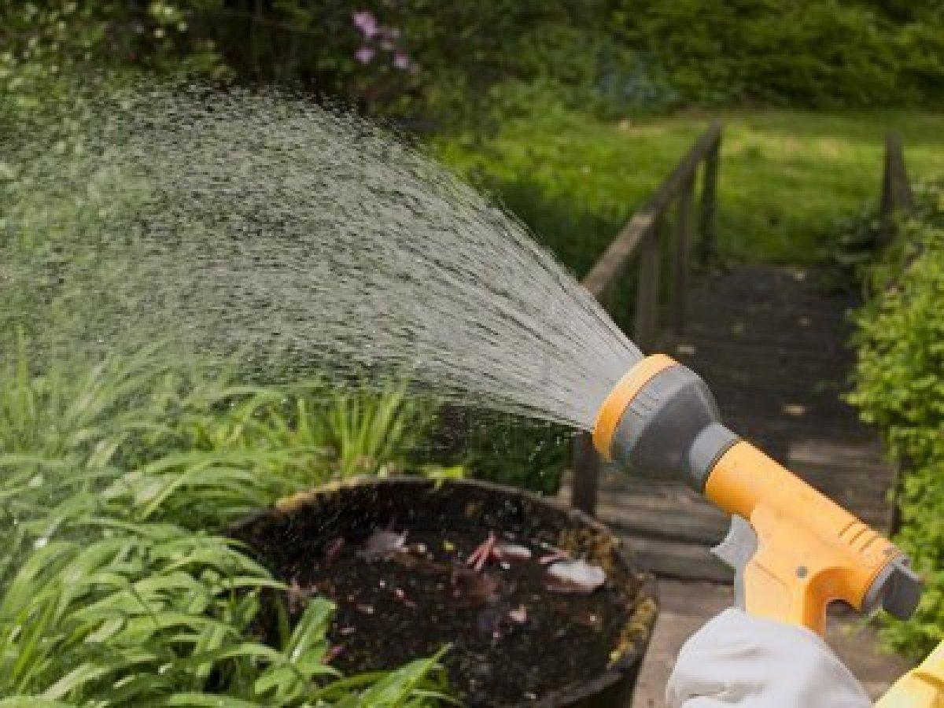
Seasonal Strategies
Early/Mid Summer
Watering
Young raingarden plants need about 1” of water per week

Slide 23
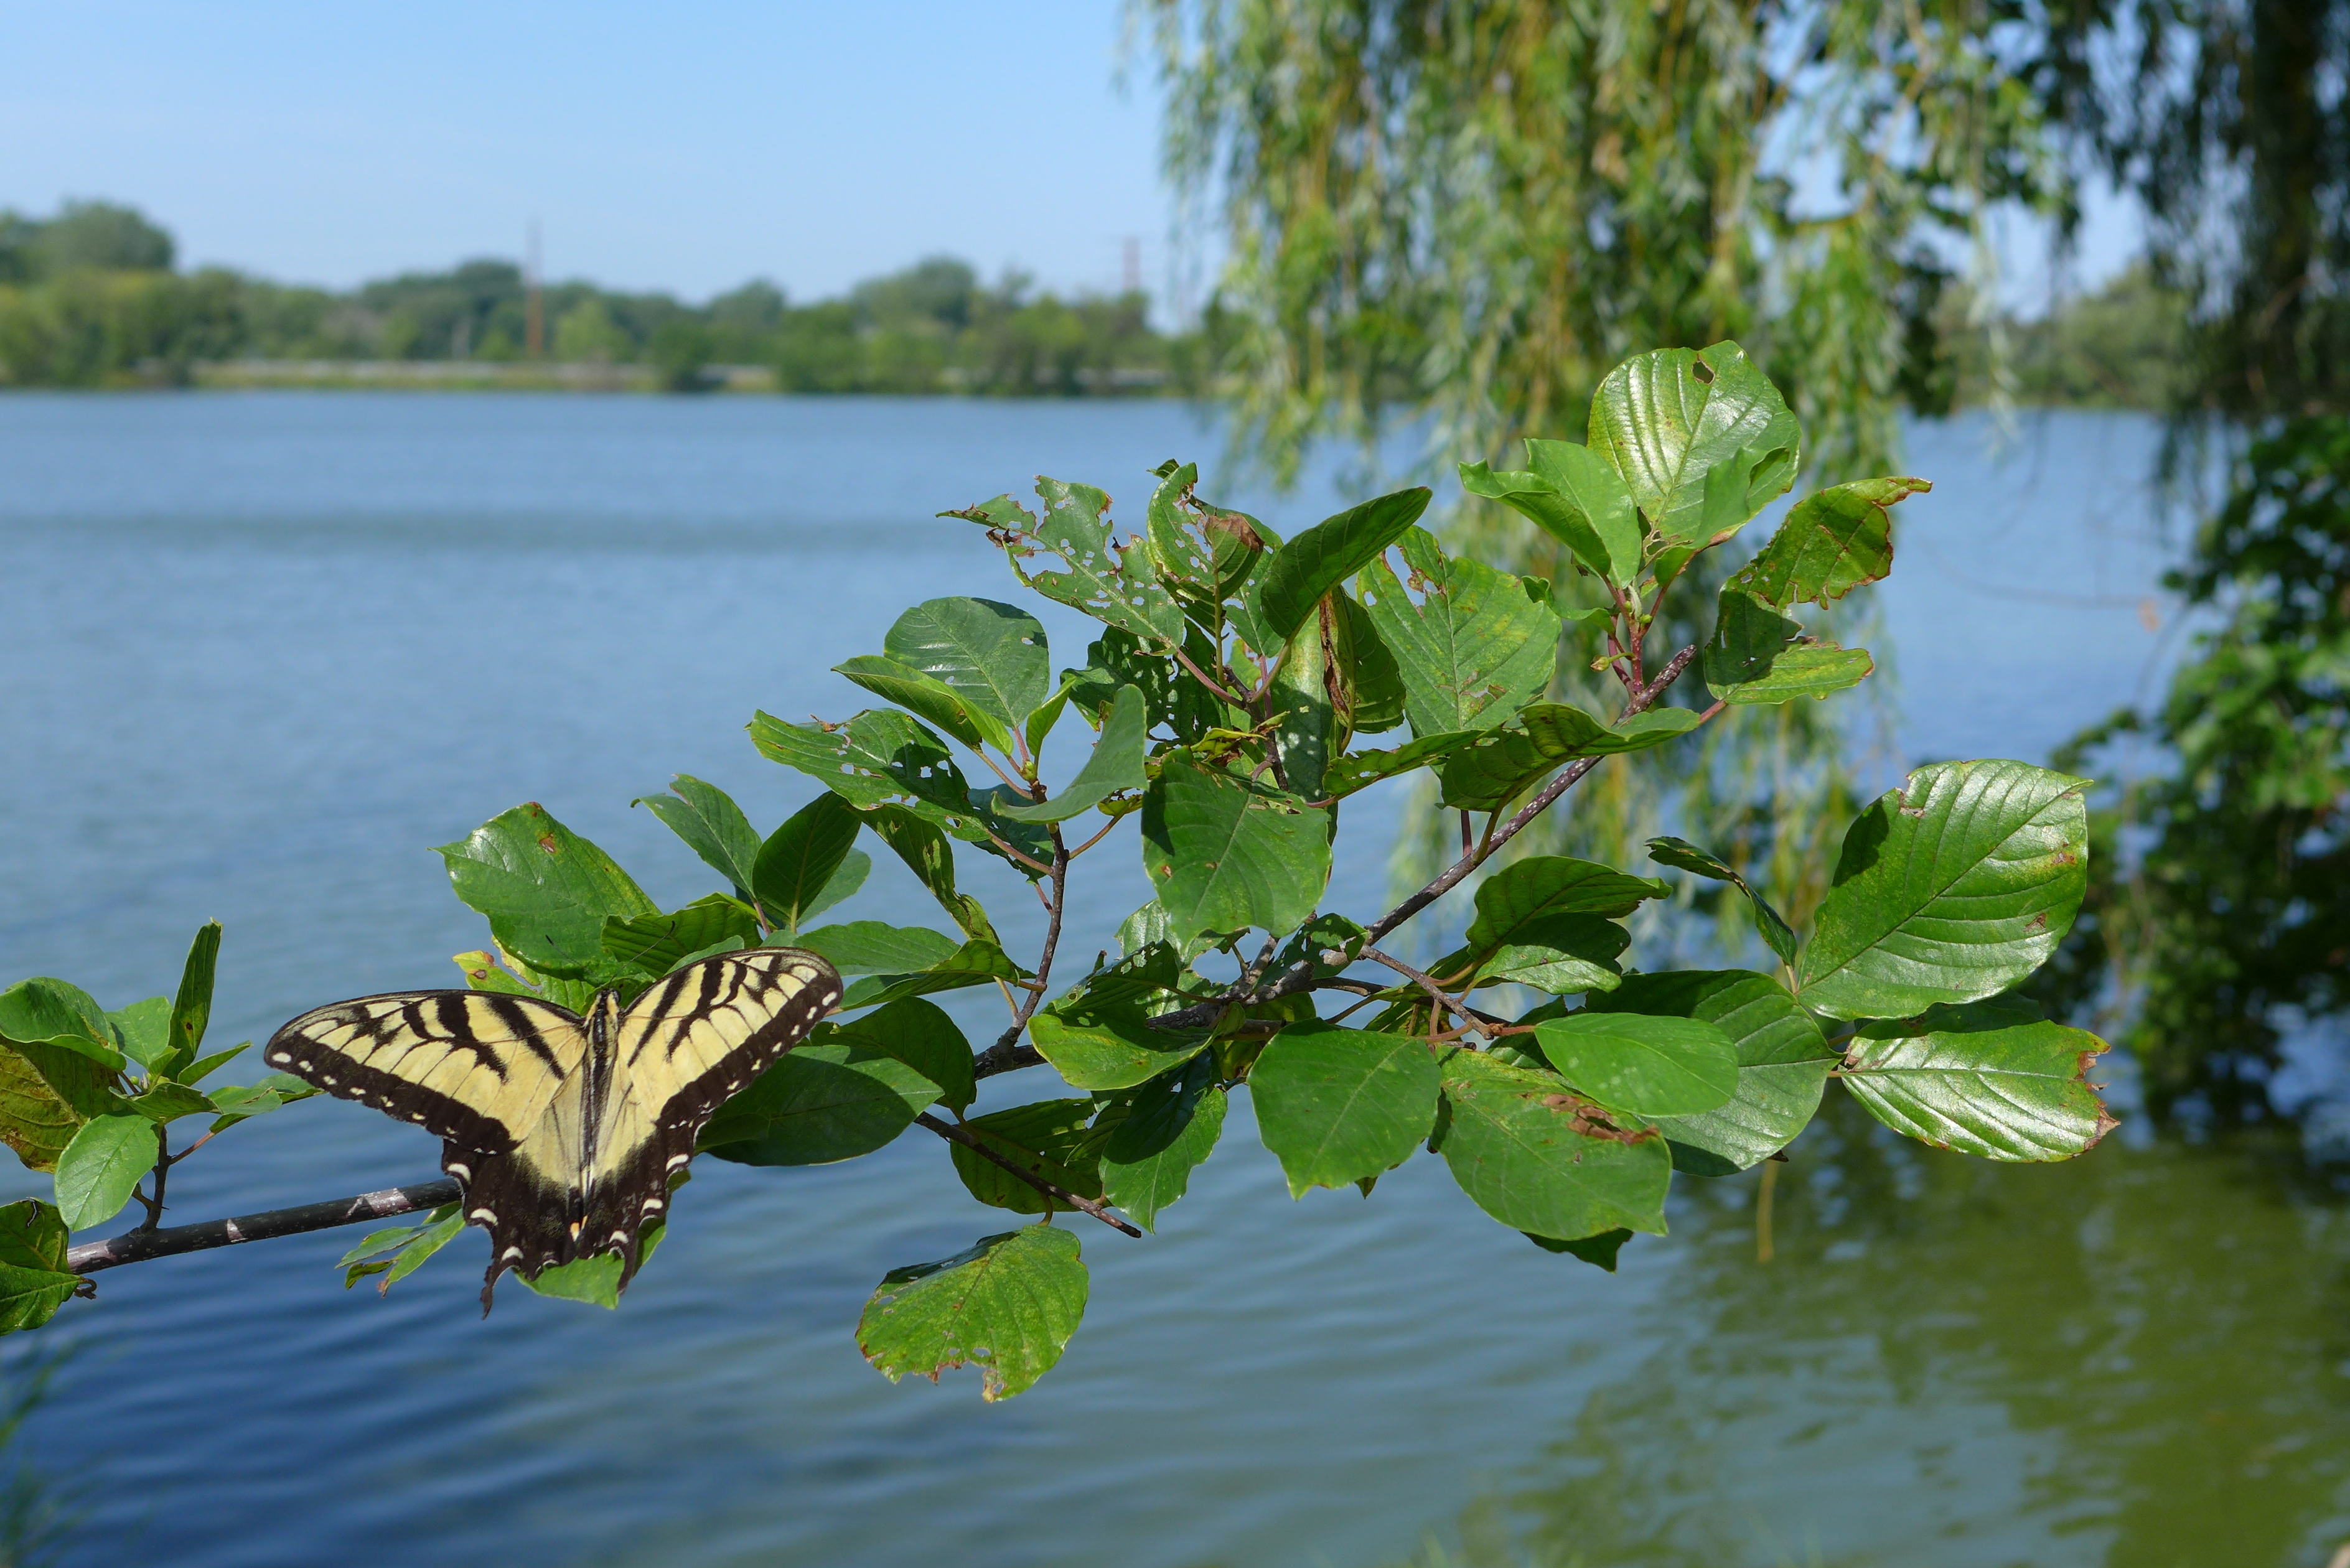
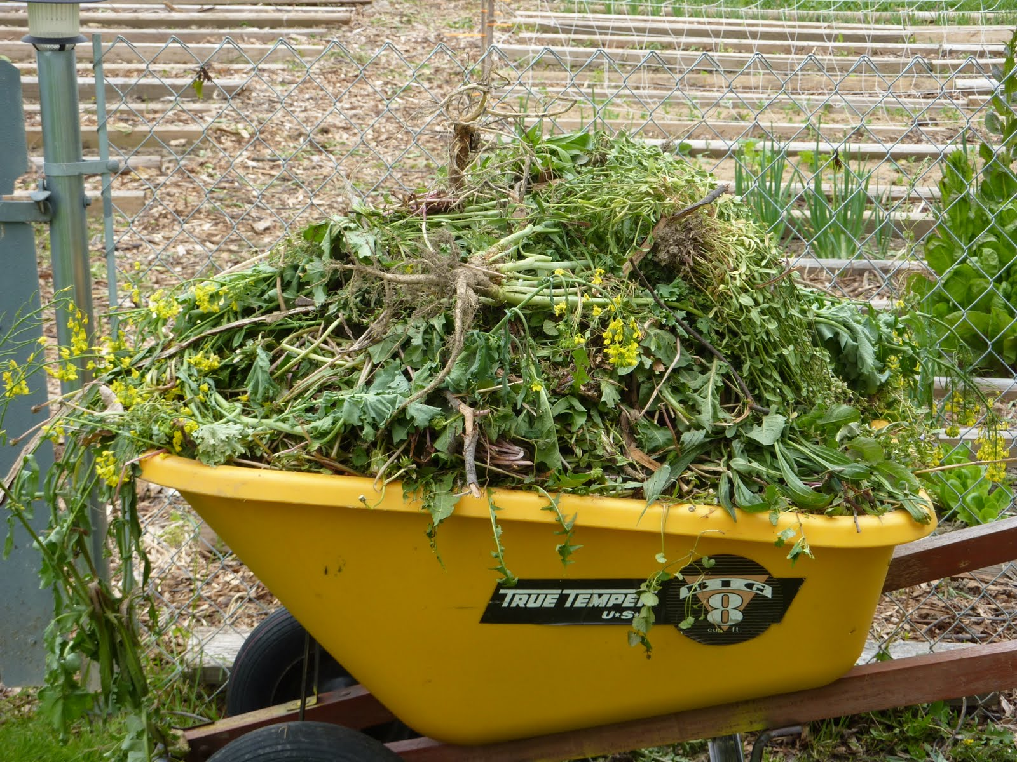
Seasonal Strategies
Mid Summer
Weeding
Second round of warm-season weeds and grasses. Pull or spot-spray and re-mulch areas that are getting run over with weeds.

Slide 24
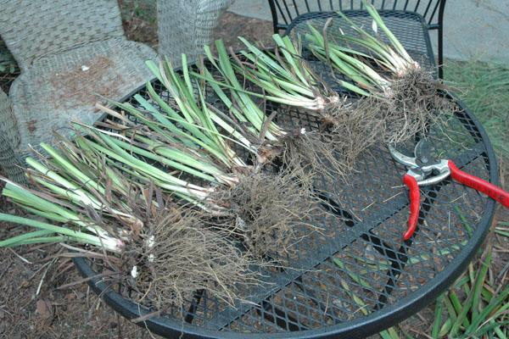
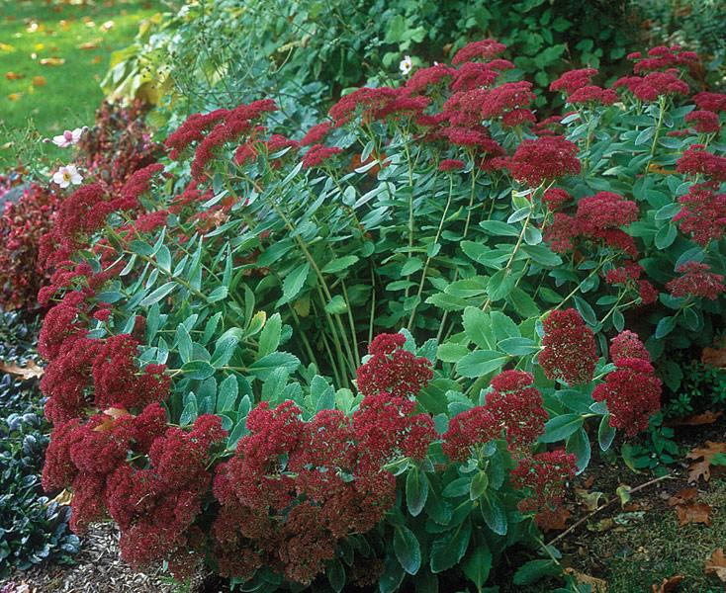
Seasonal Strategies
Late Summer
Dividing
Iris, lilies, peonies are the only plants to be divided in late summer. Flag other plants that need dividing for easy identification in Spring
Notes:
Most plants should be divided in late spring or early summer. Irises, lillies and peonies should only be divided in late summer. Other plants can be marked for division in the spring.

Slide 25
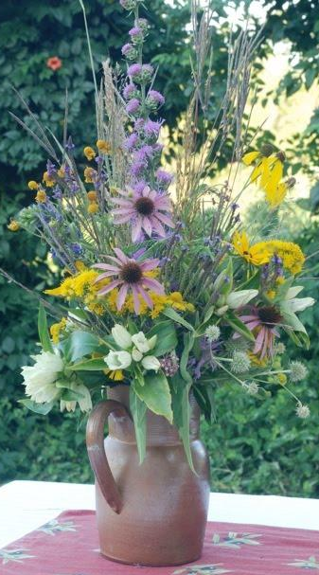
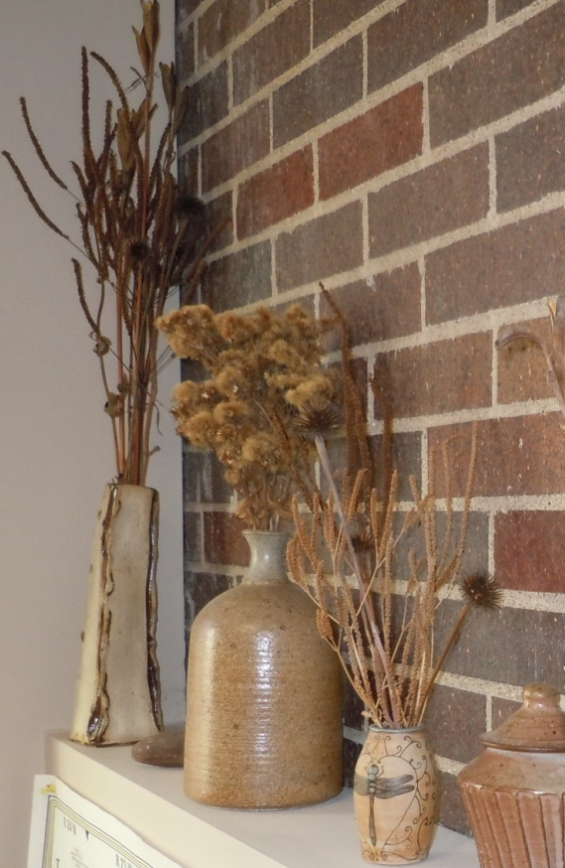
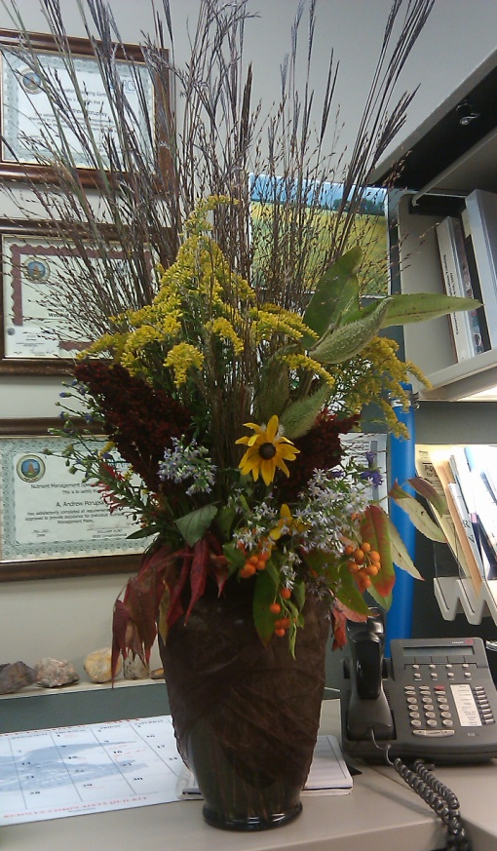
Seasonal Strategies
Late Summer
Bouquets
Notes:
Most plants should be divided in late spring or early summer. Irises, lillies and peonies should only be divided in late summer. Other plants can be marked for division in the spring.

Slide 26
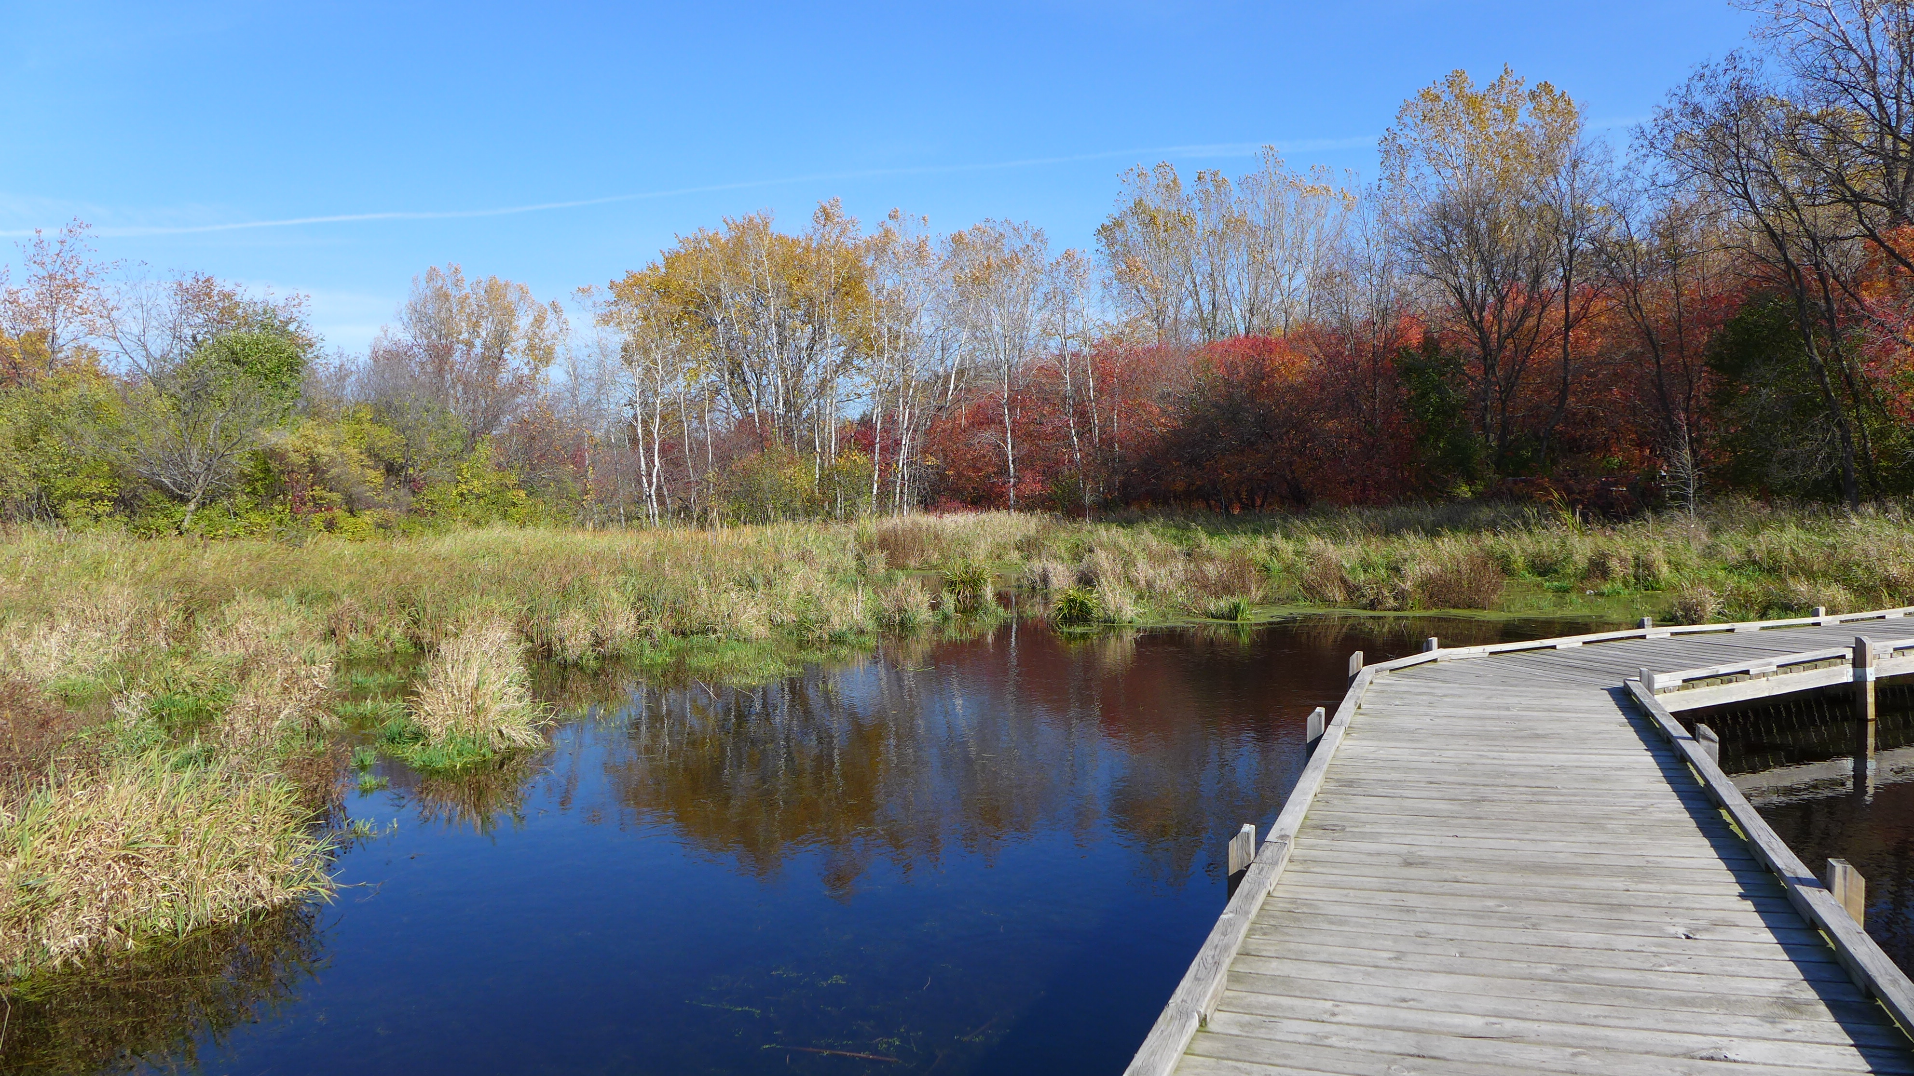
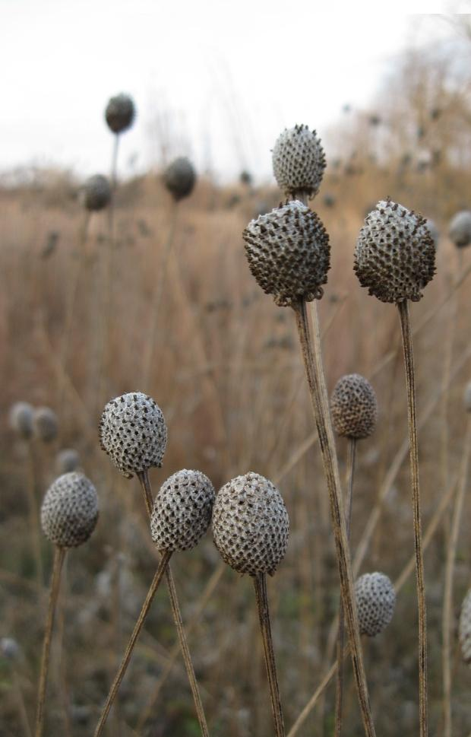
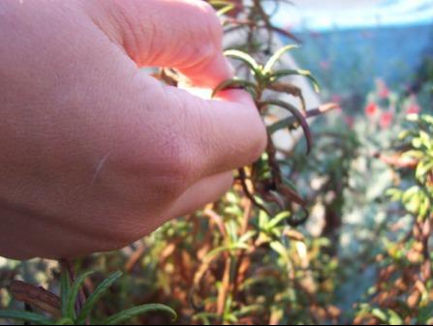
Seasonal Strategies
Fall
Seed Collection
Ripe seed is generally dry, hard, and
Can’t be punctured by a thumbnail
Notes:
Ripe seed is generally dry, hard, and cannot be punctured by a thumbnail

Slide 27
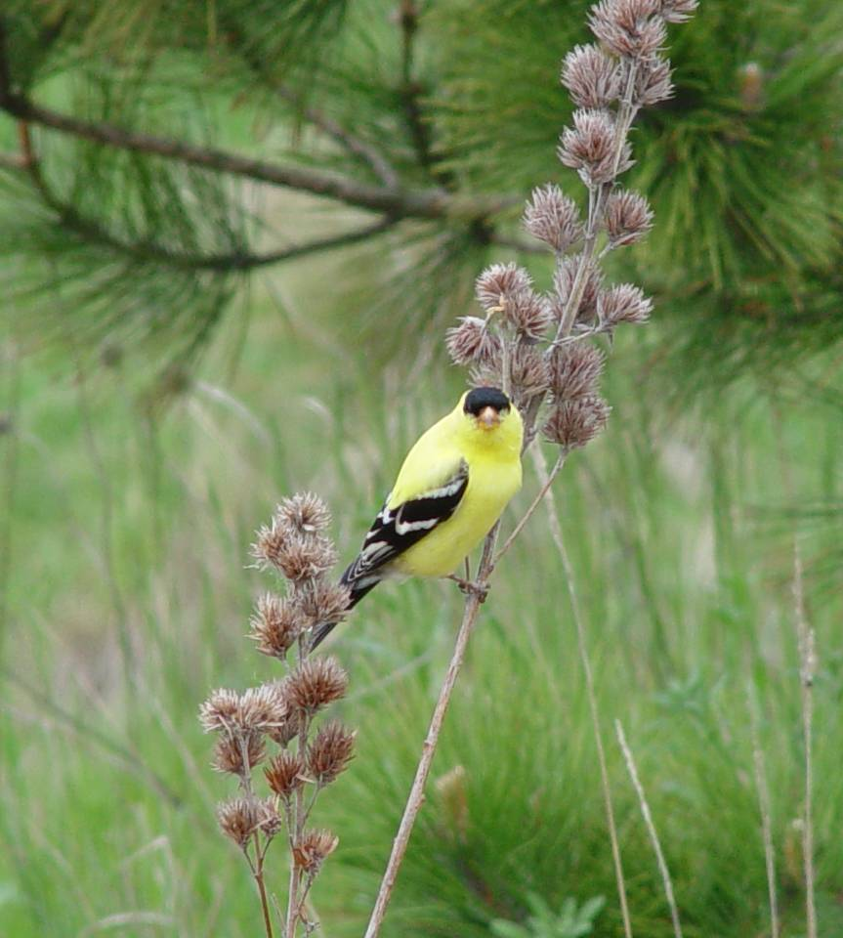
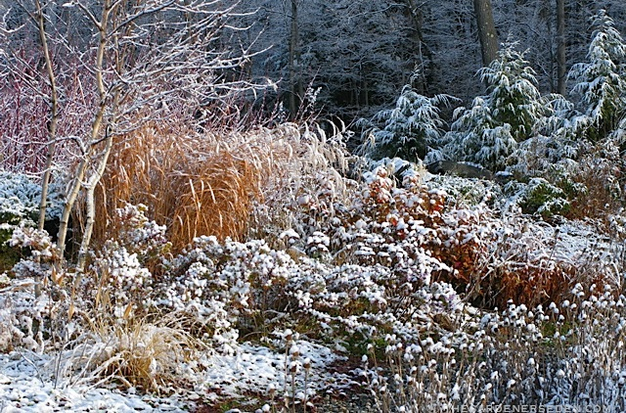
Seasonal Strategies
Fall
Leave some standing
Creates seasonal interest, provides habitat and food
Notes:
Leaving plants standing provides protection against crown damage for plants during the winter. Plants that should be left standing over the winter include: Asters, Black-eyed Susans, Butterfly Milkweed, Cardinal Flower, Blazing Star, Joe Pye Weed, Lupine, Purple Coneflower,

Slide 28
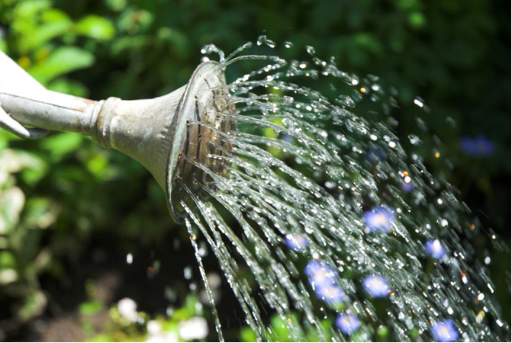
Seasonal Strategies
Fall
Watering
Water into the fall to keep adequate soil moisture
During dry periods, keep plants watered until ground freezes (especially trees and shrubs).
Notes:
Leaving plants standing provides protection against crown damage for plants during the winter. Plants that should be left standing over the winter include: Asters, Black-eyed Susans, Butterfly Milkweed, Cardinal Flower, Blazing Star, Joe Pye Weed, Lupine, Purple Coneflower,

Slide 29
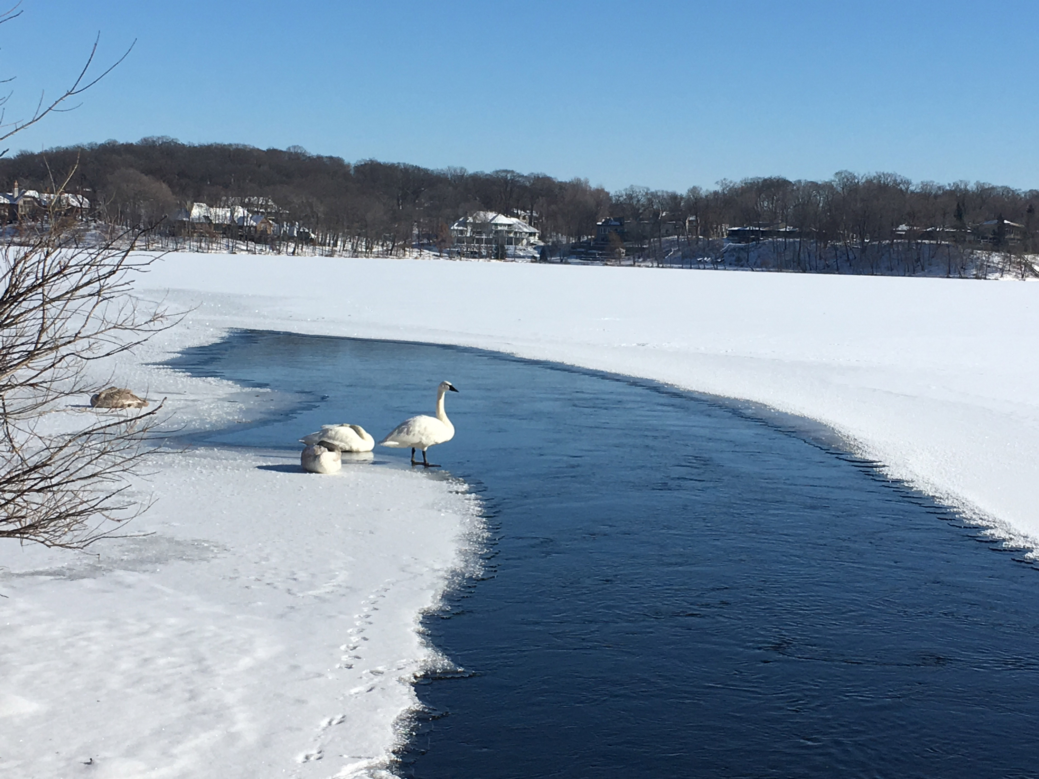





Seasonal Strategies
Winter
Rabbit Protection
Bad bunny!

Slide 30

Seasonal Strategies
Winter/ Early Spring
Pruning
To encourage new growth, remove dead, broken, or diseased branches.
Produce larger fruits or flowers.
Remove suckers or spindly growth

Slide 31

Seasonal Strategies
Early Winter/ Early Spring
Pruning
Typically when the plant is dormant.
Use hand pruner or loppers.
Make a clean angle cut just above a bud.

Slide 32


Raingarden Fix-it
Group exercise
Split into groups
Each group will be given a set of cards. There are 10 problem cards and 10 fix cards.
Match the problem with the best fix.

Slide 33



Resources
Maintenance Guide
Plant identification field guides: Sherburne soil and Water Conservation District.
Notes:
Blue Thumb experts are here to help- we won’t abandon you after you install the raingarden
Master gardeners can be contacted by calling a hotline or by an online form- you can even attach photos to help answer your question. You will typically receive an answer within 48 hours.
The University of Minnesota Extension office has many publications that address common questions
Local nurseries are great at answering plant-specific questions.

Slide 34
Resources
Blue Thumb experts
U of MN Extension & Master Gardener Plant Clinics
Monday, May-Sept
Friday, June-Aug
Local nurseries
Notes:
Blue Thumb experts are here to help- we won’t abandon you after you install the raingarden
Master gardeners can be contacted by calling a hotline or by an online form- you can even attach photos to help answer your question. You will typically receive an answer within 48 hours.
The University of Minnesota Extension office has many publications that address common questions
Local nurseries are great at answering plant-specific questions.

Slide 35
Common Problems and Solutions
Notes:
Make it easy to tell planted vs. sneak in
Mulch keeps out weeds, prevents erosion, amends soil
Gina’s example: Adaptation to yard needs/responses, 2nd raingarden addition, 2 years of observation/actions

Slide 36


Common Problems and Solutions
Notes:
Make it easy to tell planted vs. sneak in
Mulch keeps out weeds, prevents erosion, amends soil
Gina’s example: Adaptation to yard needs/responses, 2nd raingarden addition, 2 years of observation/actions

Slide 37

Common Problems and Solutions
Notes:
Make it easy to tell planted vs. sneak in
Mulch keeps out weeds, prevents erosion, amends soil
Suzanne’s example: Poor drainage, planting lilies, a raingarden, a sidewalk pipe, then attending a VLAWMO workshop. Yard consisted of poor construction soil, compost improvements.

Slide 38

Common Problems and Solutions
Notes:
Make it easy to tell planted vs. sneak in
Mulch keeps out weeds, prevents erosion, amends soil
Suzanne’s example: Poor drainage, planting lilies, a raingarden, a sidewalk pipe, then attending a VLAWMO workshop. Yard consisted of poor construction soil, compost improvements.

Slide 39




Thank you!
www.VLAWMO.org
(651) 204-6070
Notes:
Draft template for modification. It is assumed that the target audience is people who own functional raingardens (already designed and installed).

Slide 40


Weed Busters!
Group exercise
Split into groups
Each group receives a set of cards with plant photos on the front. Do not turn over the cards.
Separate the weeds from the desired plants.

